Slide 1


ISE 291 Term 231 Project : Salary Prediction
By: Group No. 1
Section: F19
Group Members:
Leen Ghazi - Zainab Alamer - Manar Abu Saeed
Zainab Al Mubarak - Zainab Aldukhi

Slide 2
Introduction
Our project will help us to
demonstrate the significance of data analytics in predicting salary based on diverse variables from the 1994 Census database.
To combine human intuition with data-driven approaches to uncover new insights and enhance understanding in the field of data analytics.
Key Components:
Data Collection: Utilizing the Barry Becker 1994 Census database.
Variable Analysis: Investigating factors such as education, age, native nation, and relationship status that potentially impact compensation.
Prediction Models: Developing models to predict salary based on the identified variables. Insight Generation: Extracting valuable insights to improve understanding and drive further research and innovation.

Slide 3
Introduction
Expected Outcomes:
Uncovering correlations between variables and salary prediction.
Enhancing the performance of prediction models to potentially increase income.
Advancing knowledge in data analytics and its
application in decision-making processes.

Slide 4


phase1 :
Discovery

Slide 5

About the dataset
The dataset represents 32561 records of individuals, which contain some important information such as age, workclass, final weight, education, marital status, occupation, relationship, race, sex, capital gain and loss, hours per week, native country, and whether the salary is greater than $50,000. Since the salary is considered the motivation for the majority of students and employees, it is very important to get an estimation of the salary and avoid making decisions that could negatively affect people's life. Salary prediction can be used to determine where jobs' compensation is not specific, help employees or students who decide to live in the US, improve recruitment and salary standards, and provide more reasonable salaries to attract and discover talents.

Slide 6

Business Idea
problem
The U.S. is the leading study abroad destination, with prestigious institutions and global university dominance. Over 1.5 million international students received Optional Practical Training (OPT) in the last 15 years. Salary expectations, particularly surpassing $50,000, play a crucial role in students' decisions to pursue this post-graduation work opportunity.
Objective
Hypothesis
Developing a classification model for salary prediction involves identifying patterns among variables like education, age, work class, and gender. This project aims to build an accurate model classifying individuals making over $50,000. This predictive tool is valuable for students planning to study and work in the U.S.it.
The salary of an individual can be accurately predicted if it is greater than $50,000 or less based on a set of relevant features related to their age, education, work experience, status, and job-related factors.

Slide 7

phase2 :
Data Preparation

Slide 8
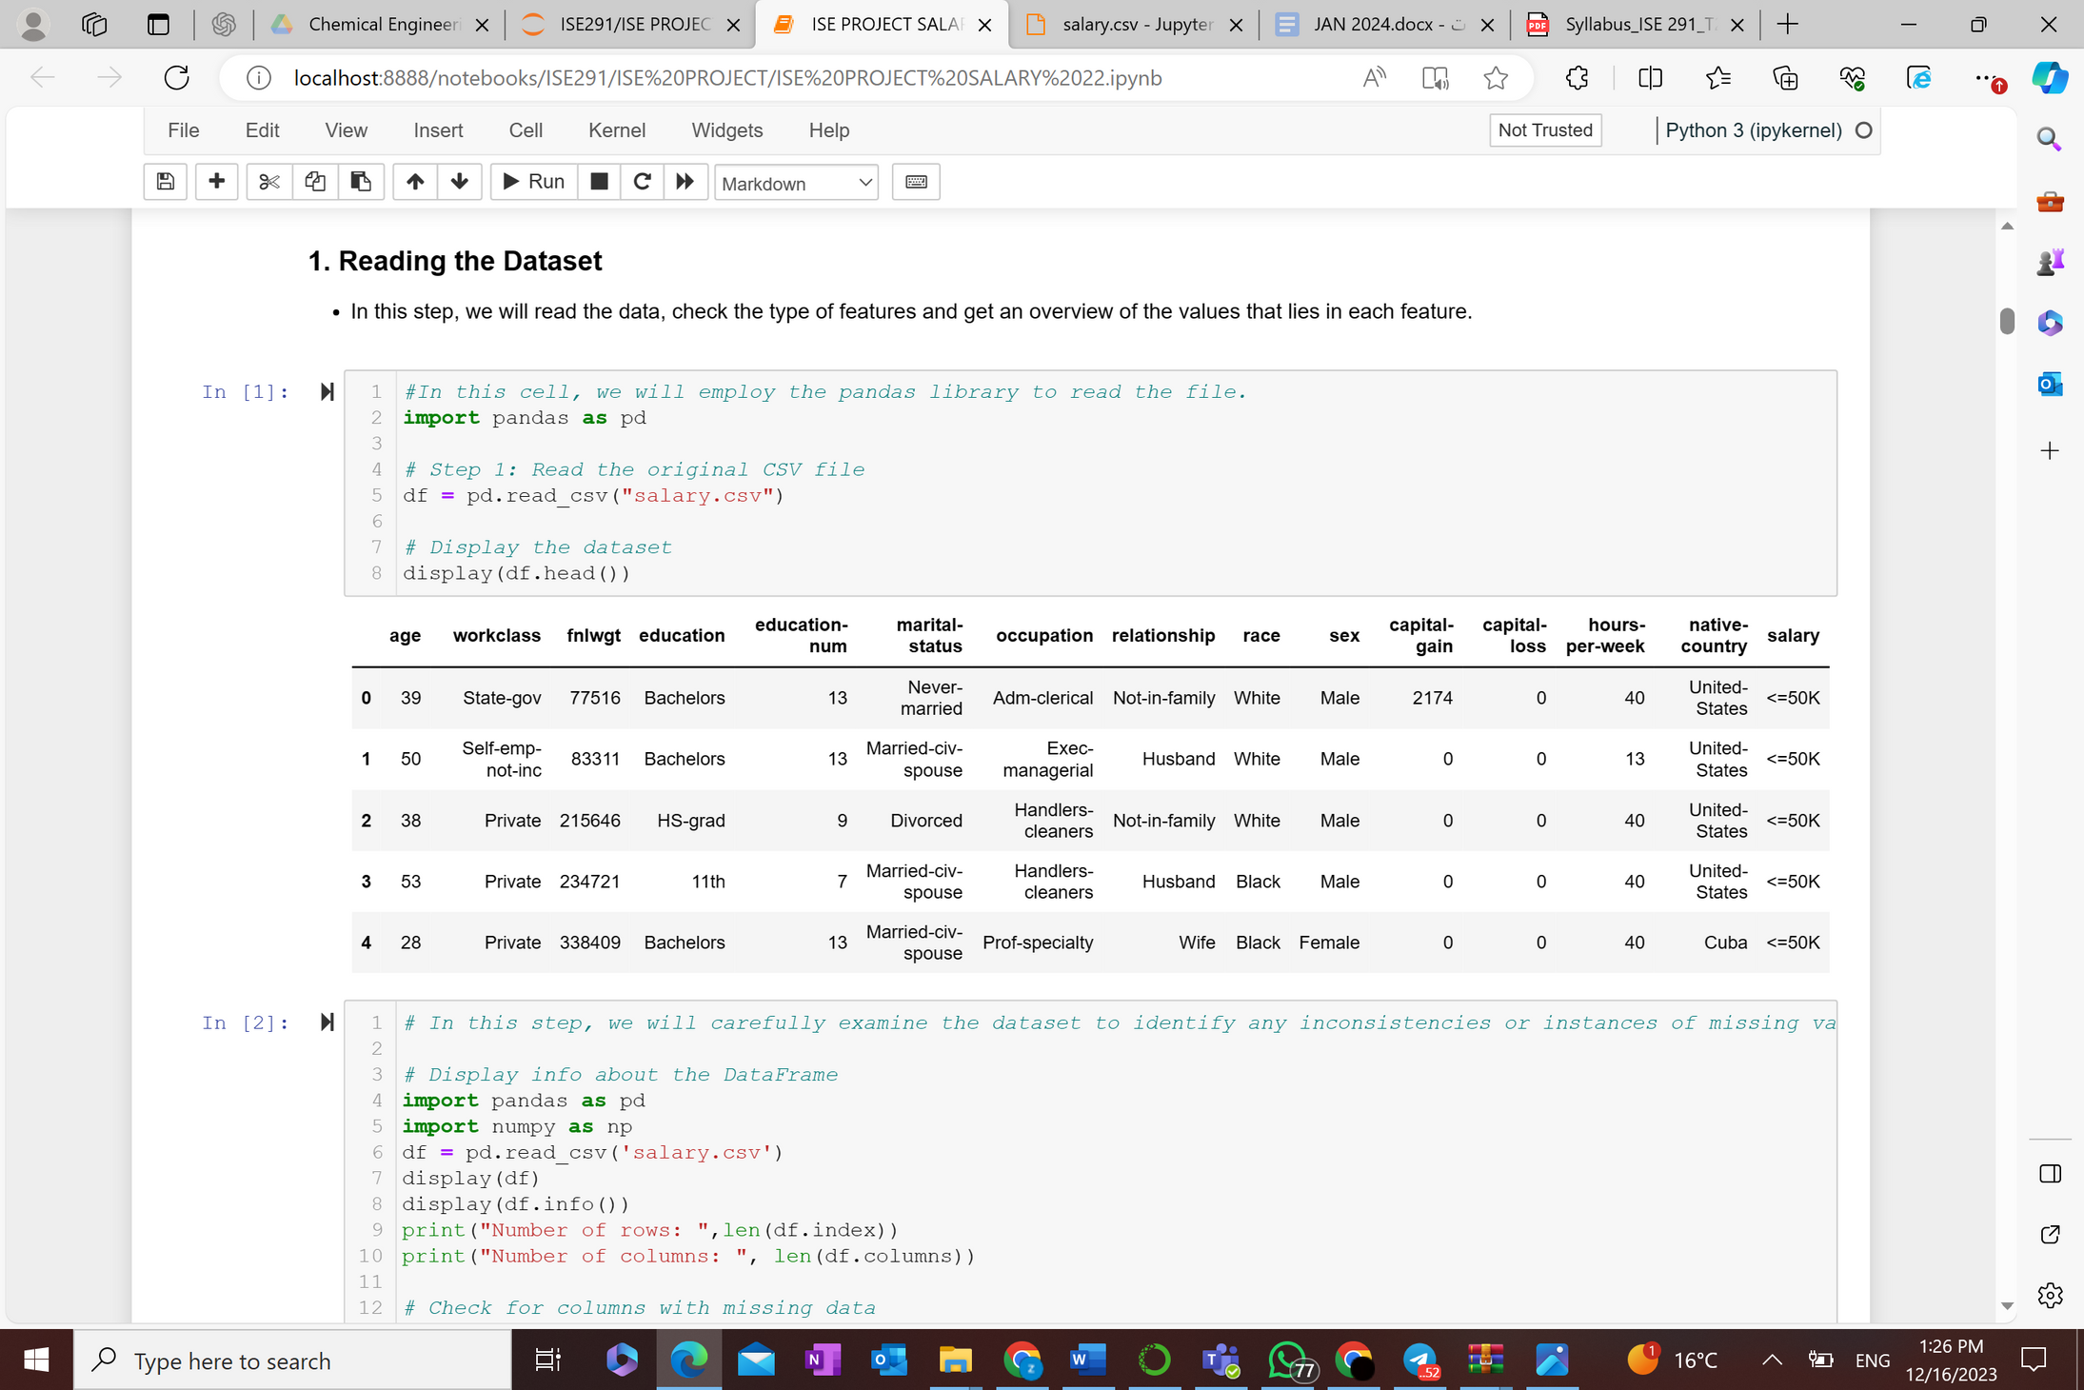
In this stage of our project, we focus on preparing the salary dataset for subsequent analysis and model building. This process is critical as it ensures the quality and integrity of our data, which directly influences the outcomes of our analysis. The key steps in this phase include:
Reading the Dataset: We begin by loading the dataset to understand its basic structure, including the variables it contains and their respective data types.

Slide 9
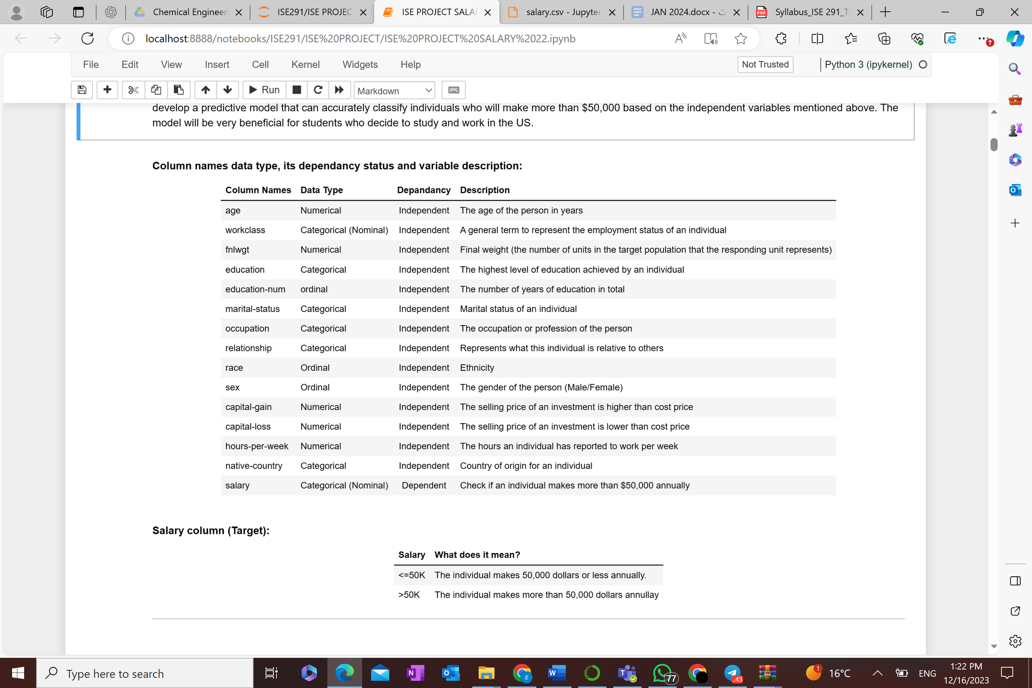

Identify the data types manually and using python

Slide 10
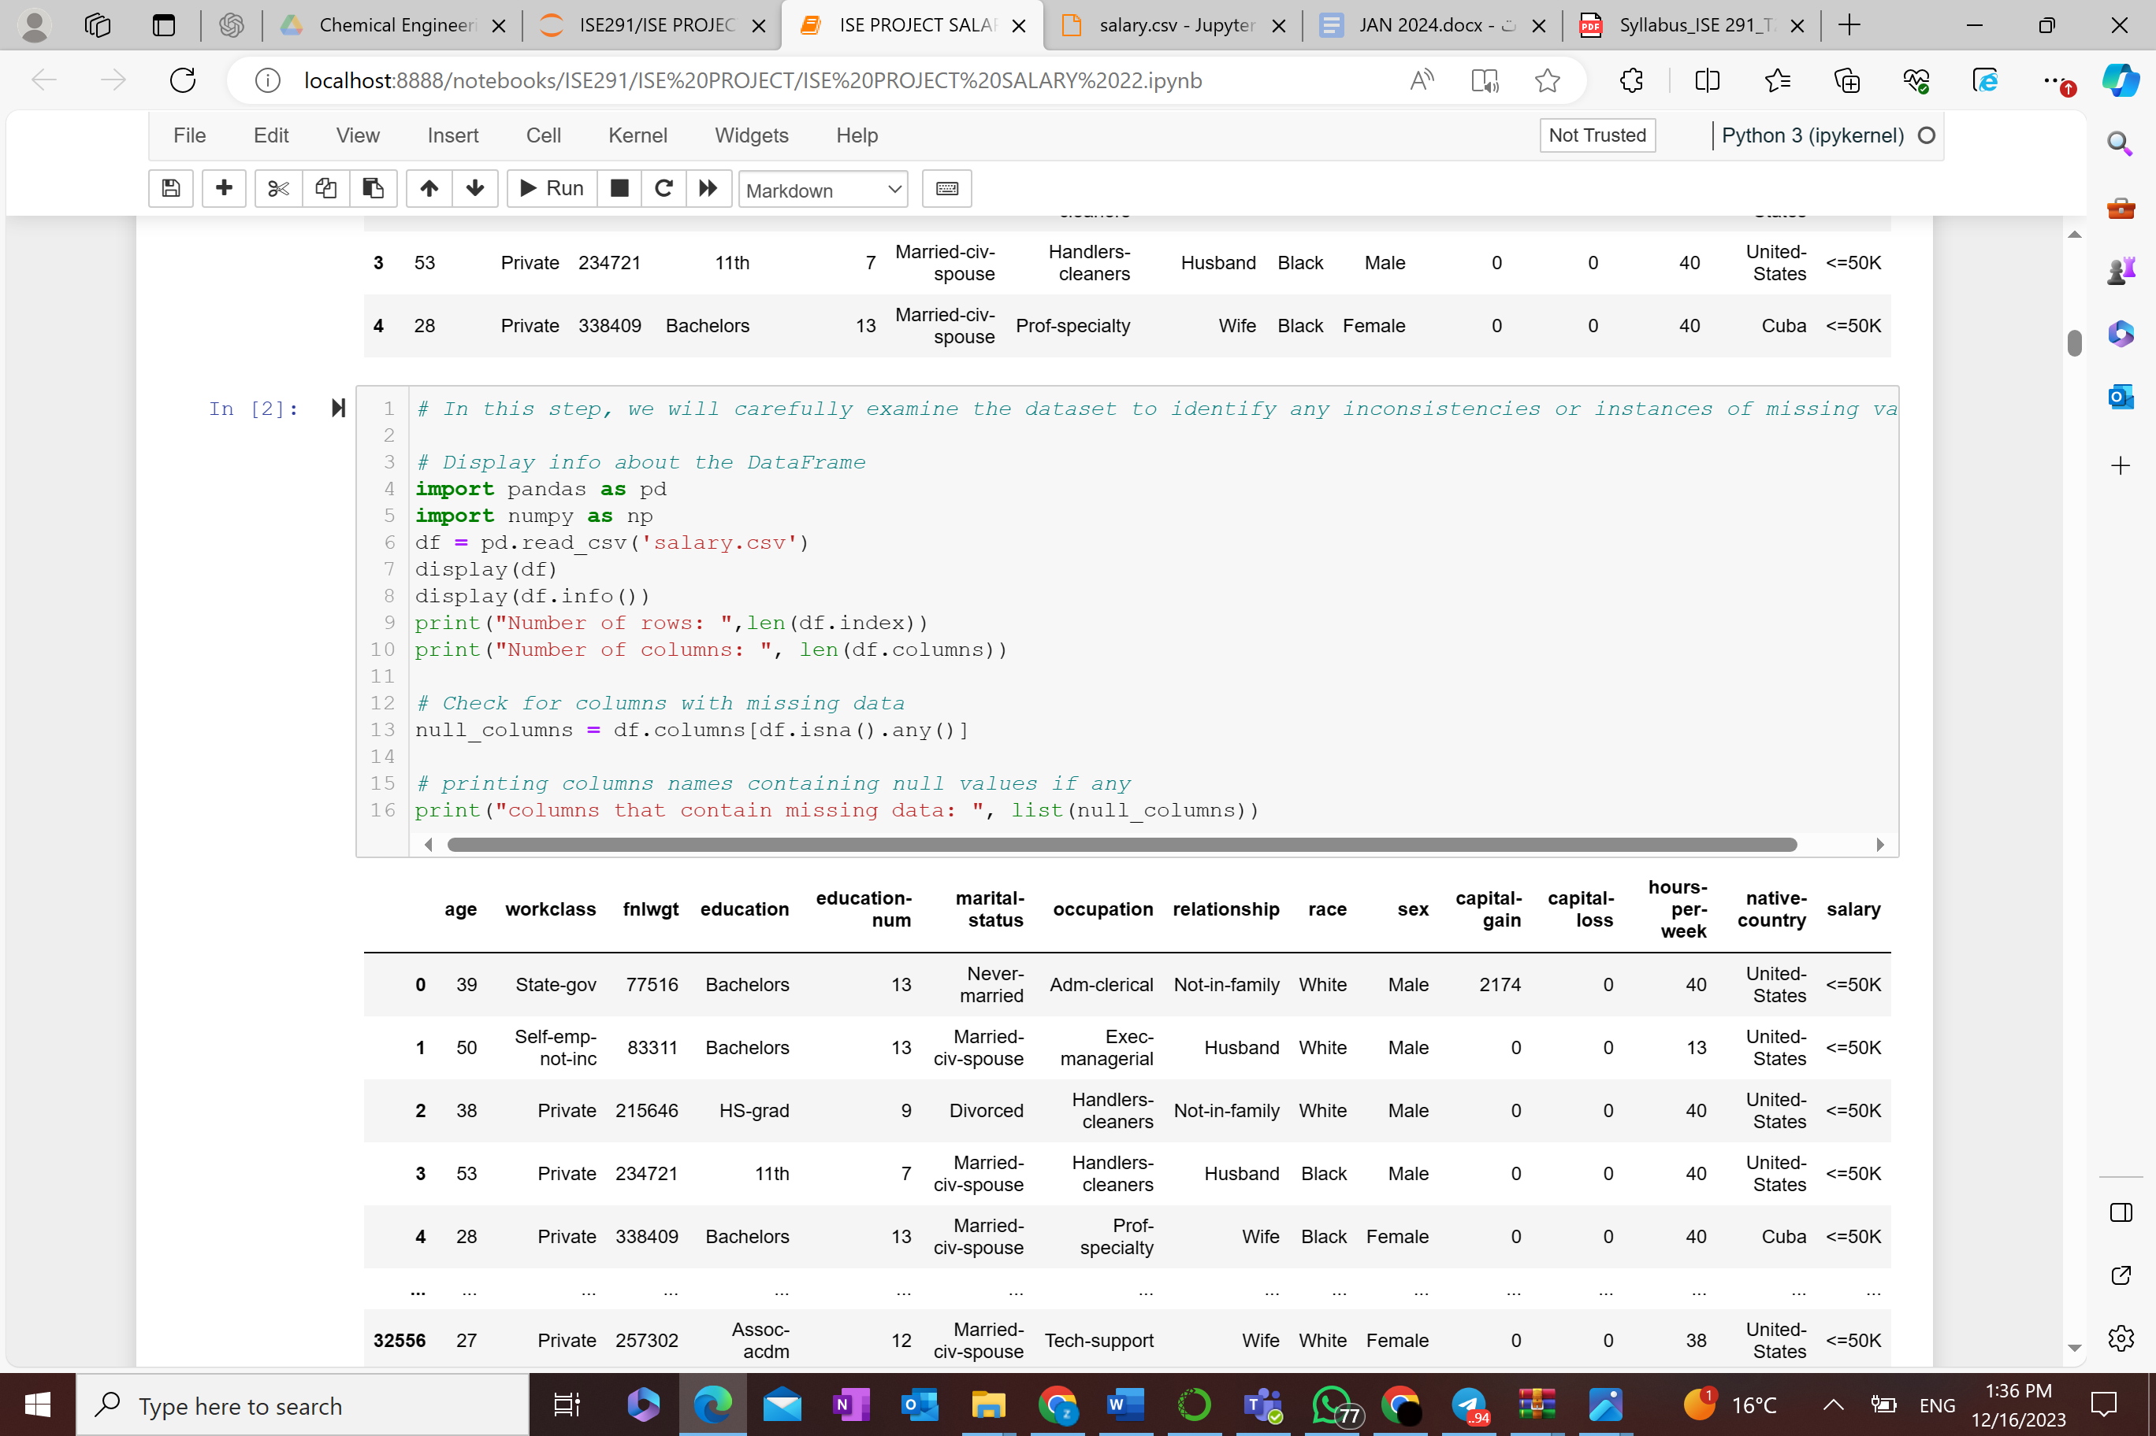
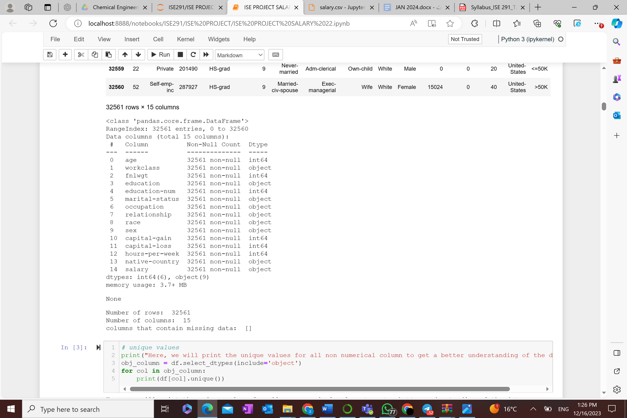
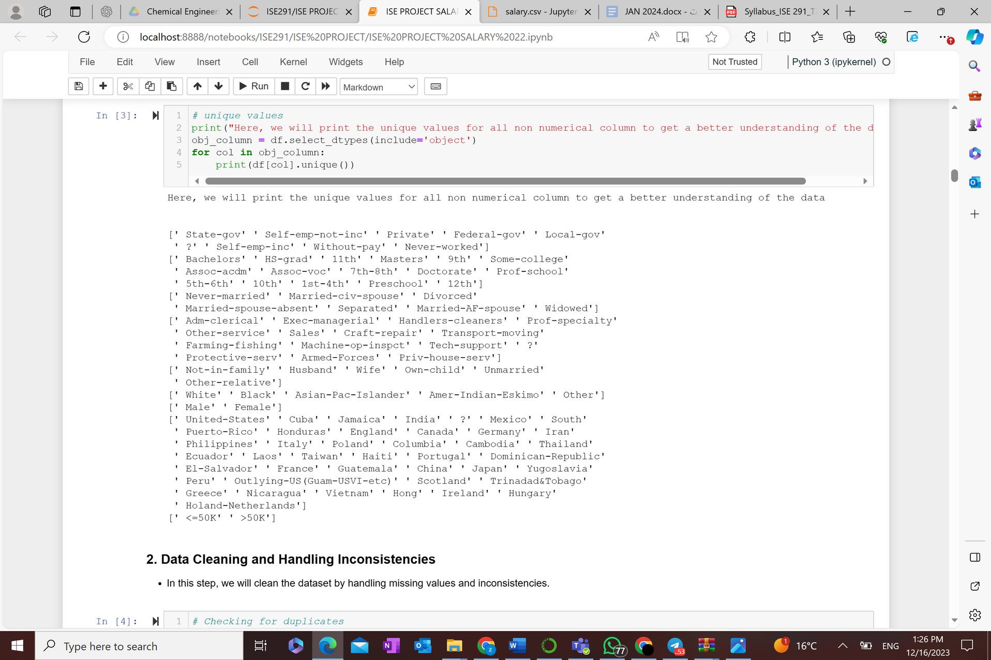

Identify inconsistencies, noise, and null

Slide 11
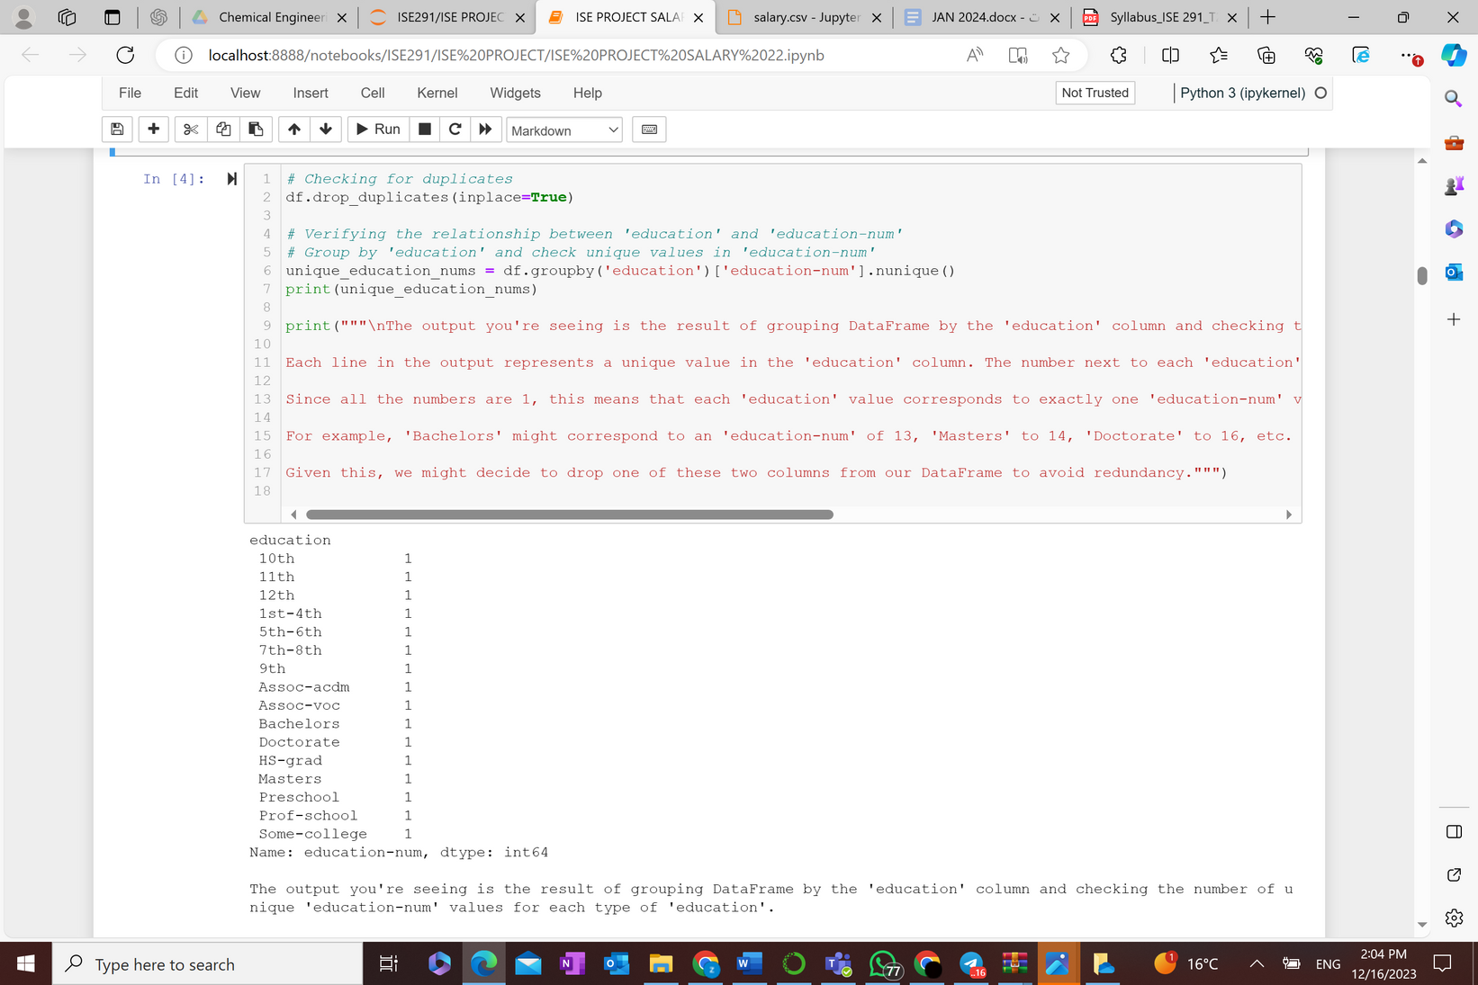
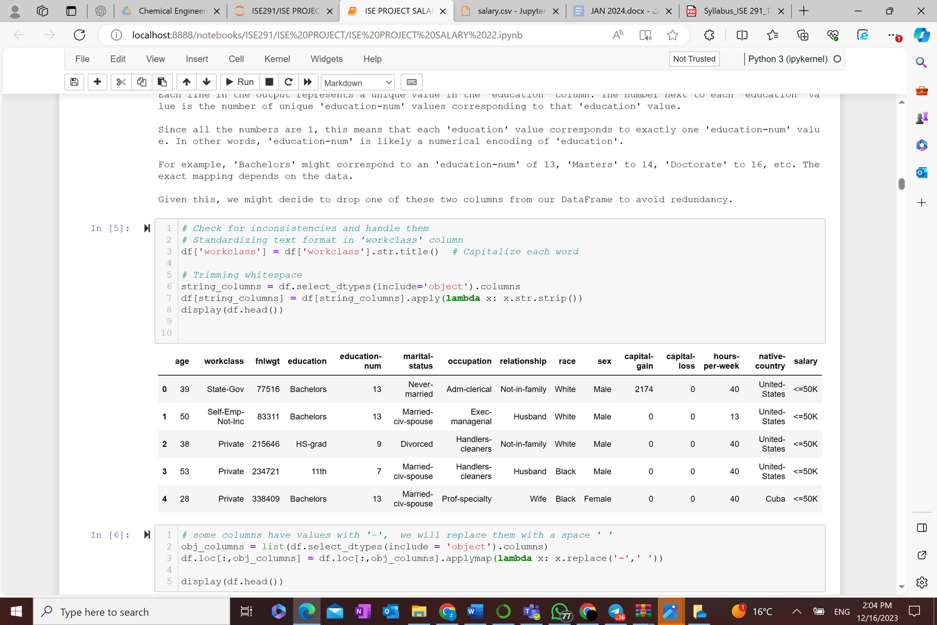
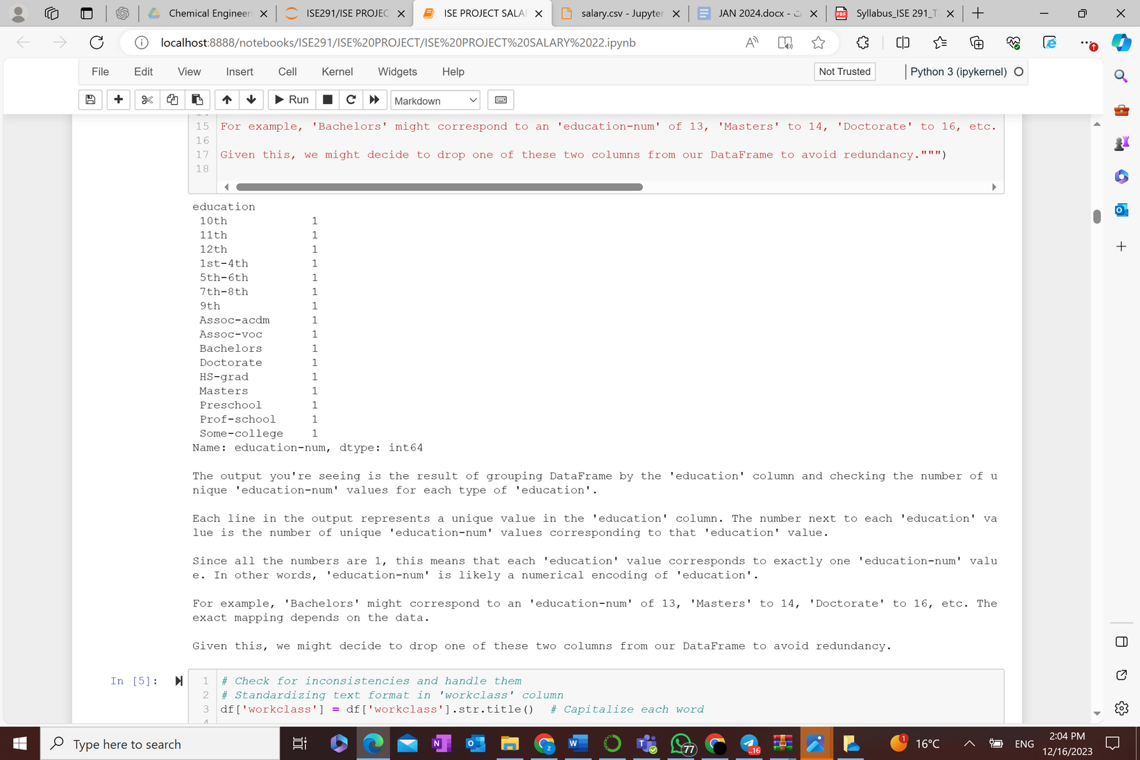

2. Data Cleaning and Handling Inconsistencies
In this step, we will clean the dataset by handling missing values and inconsistencies.

Slide 12
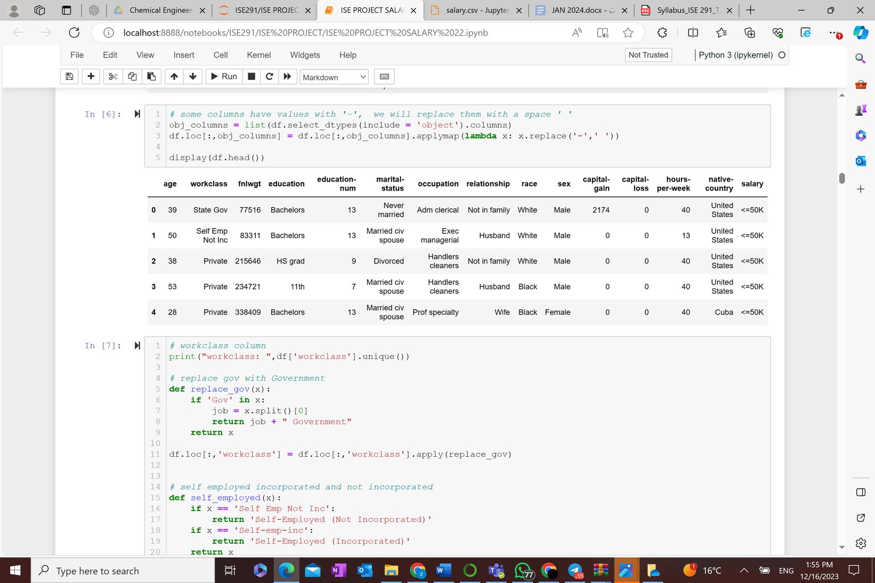

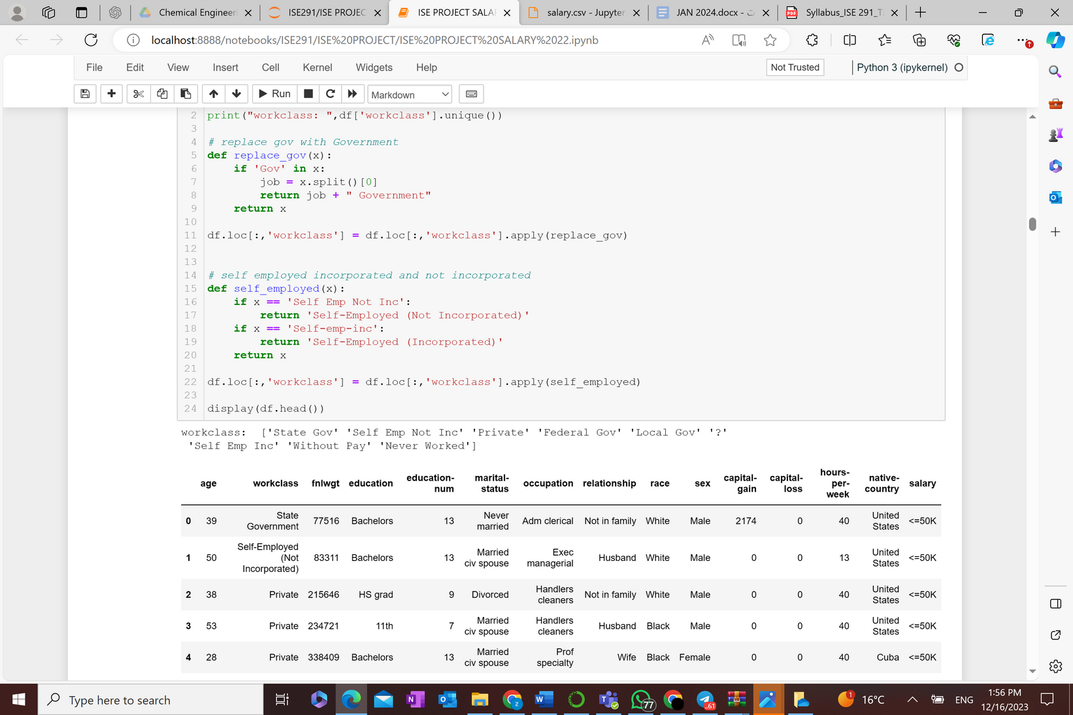

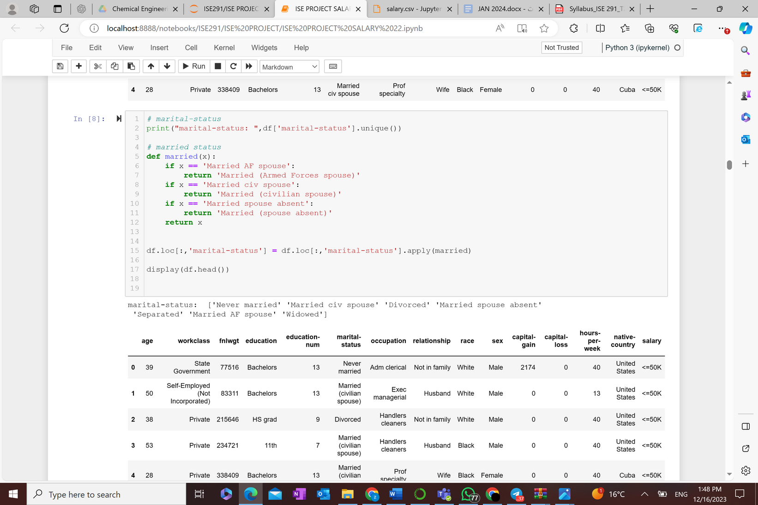

2. Data Cleaning and Handling Inconsistencies
In this step, we will clean the dataset by handling missing values and inconsistencies.

Slide 13
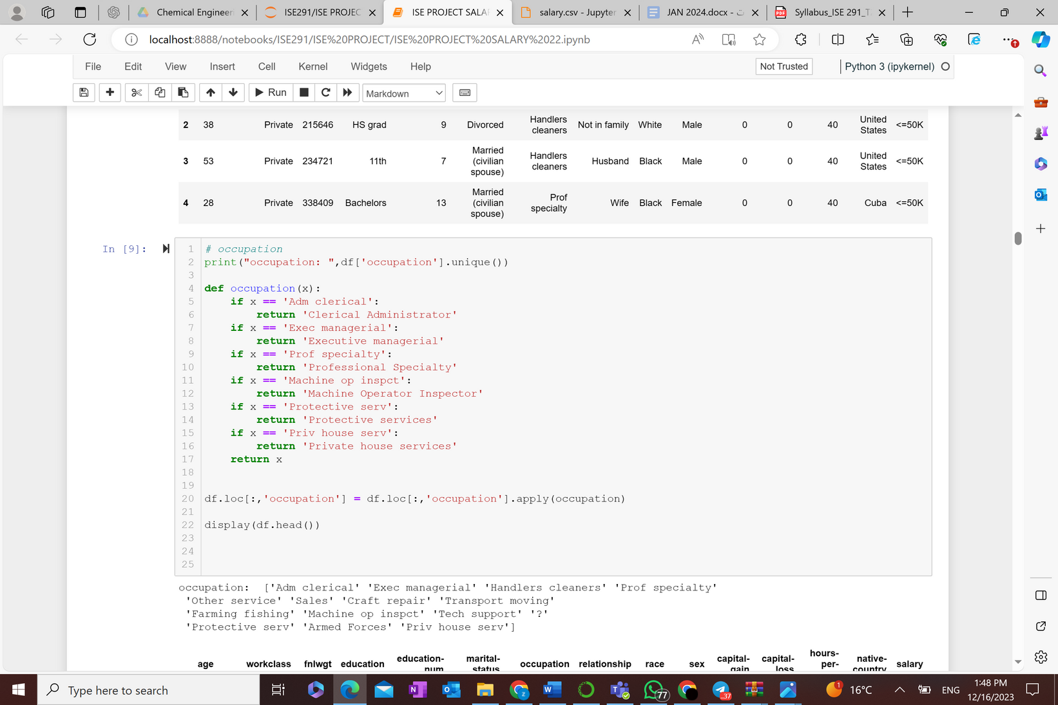
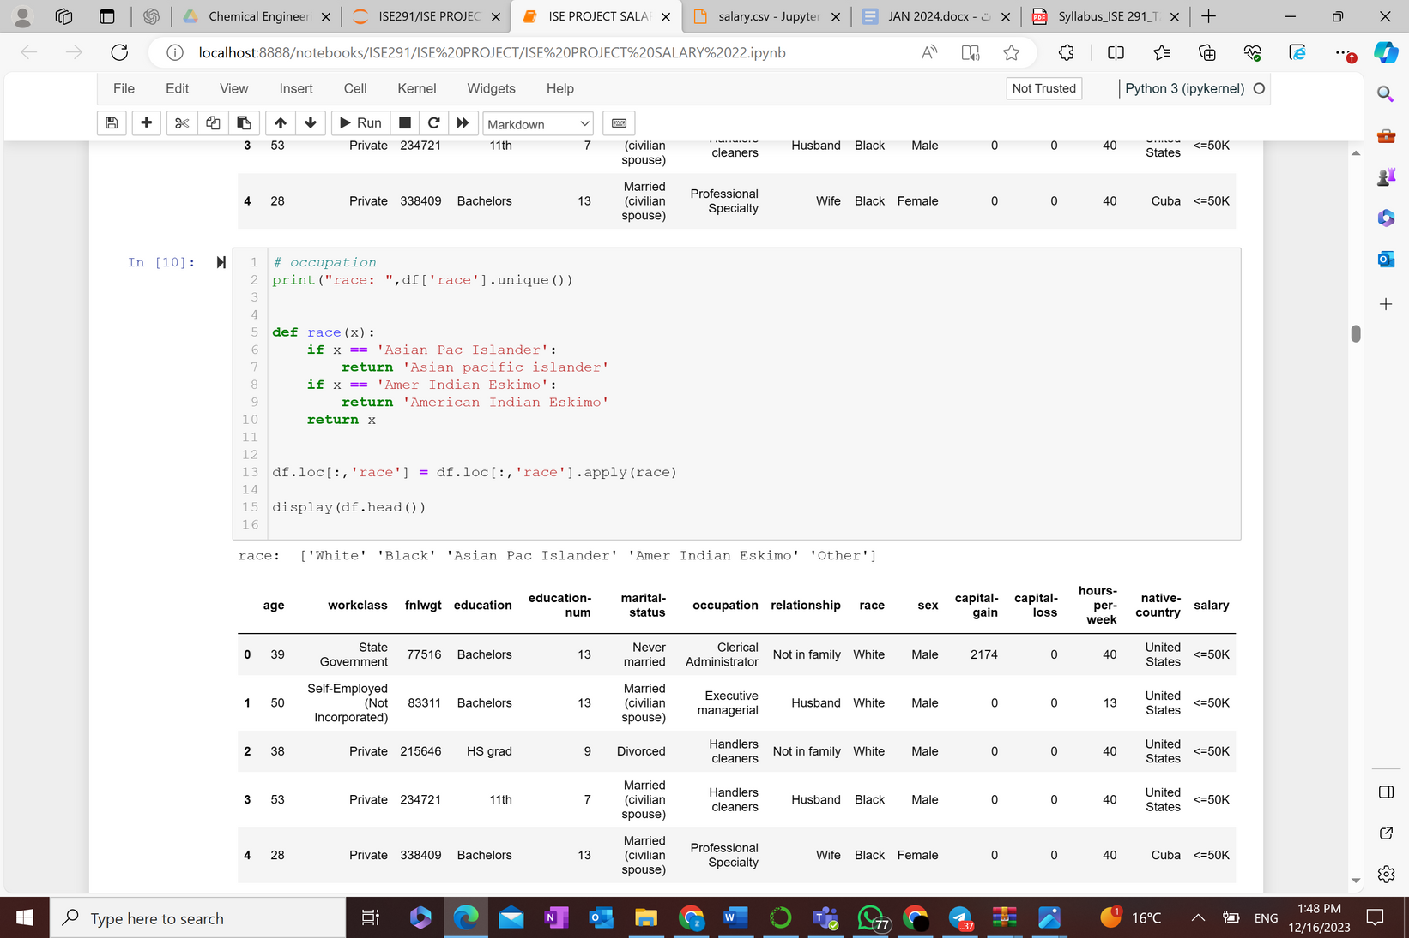



2. Data Cleaning and Handling Inconsistencies
In this step, we will clean the dataset by handling missing values and inconsistencies.

Slide 14
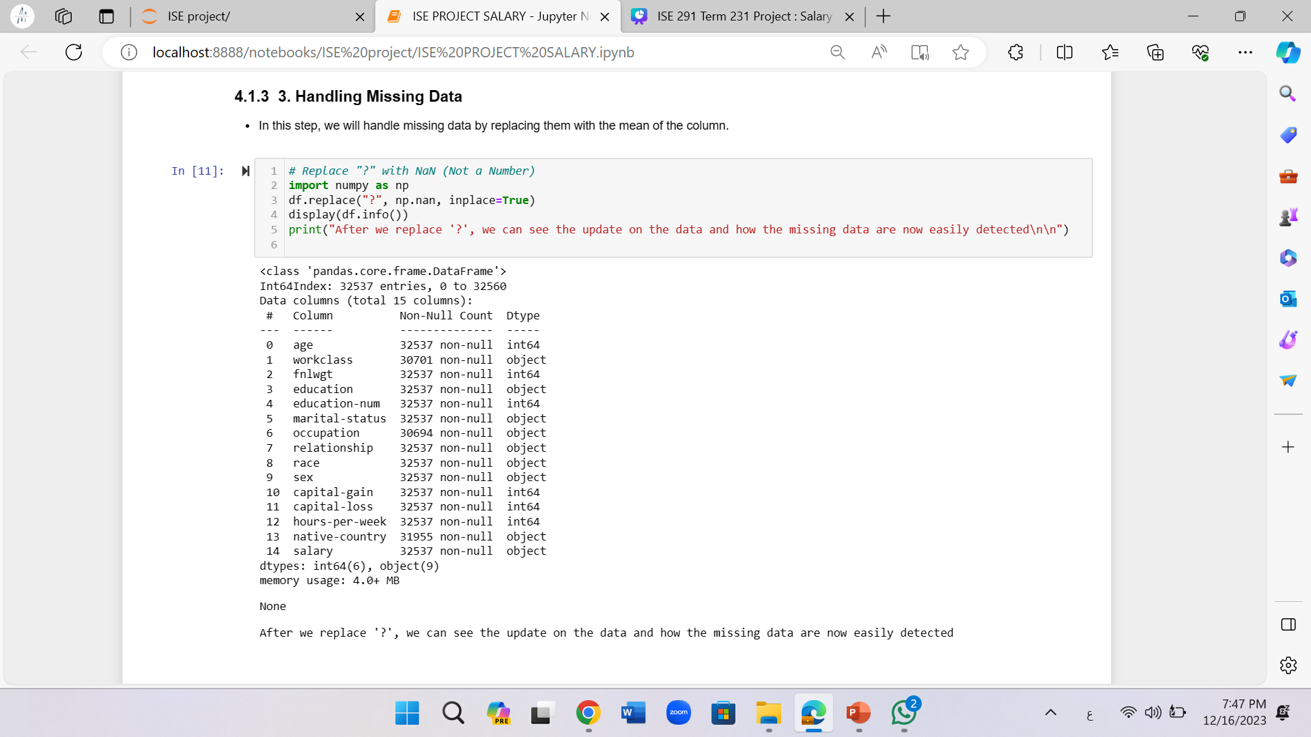
3. Handling Missing Data
Missing data can skew our analysis and lead to biased results. We will identify missing values within our dataset and employ appropriate strategies to handle them, such as imputation or removal.
First:
Replace ‘?’ by NaN

Slide 15
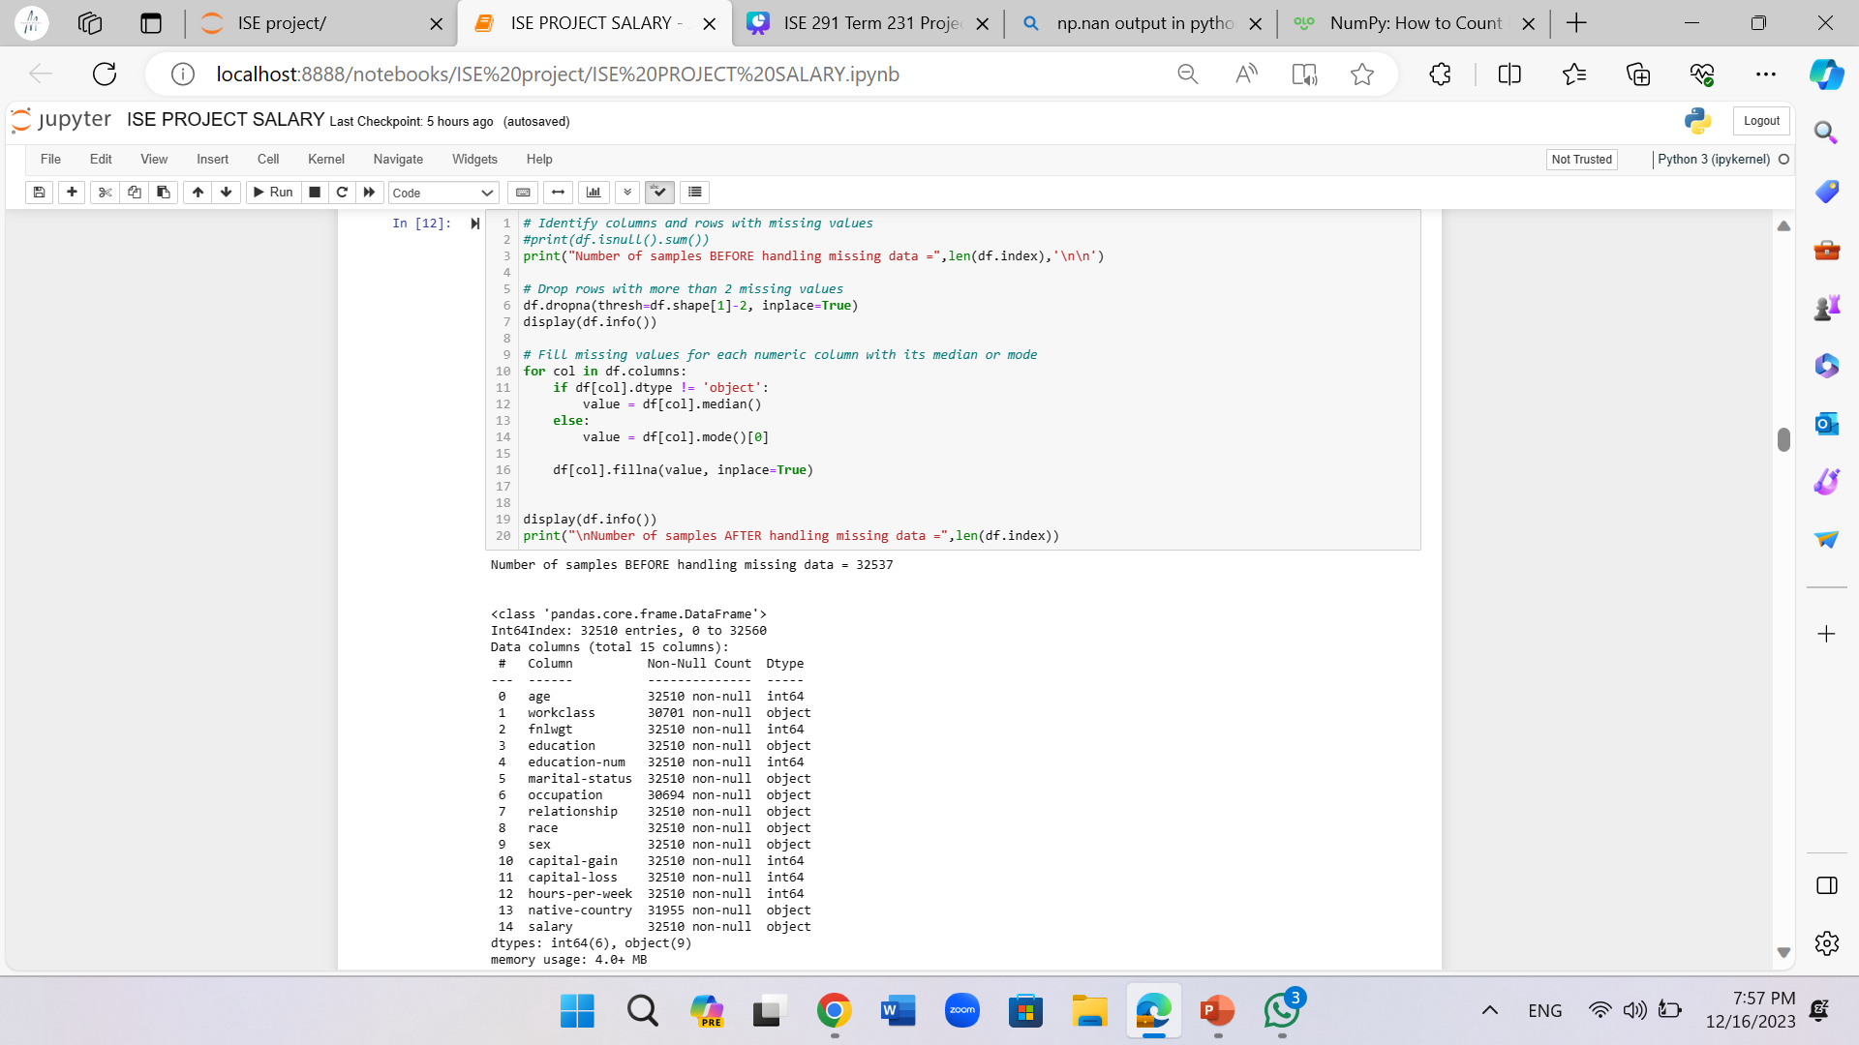
3. Handling Missing Data

Slide 16
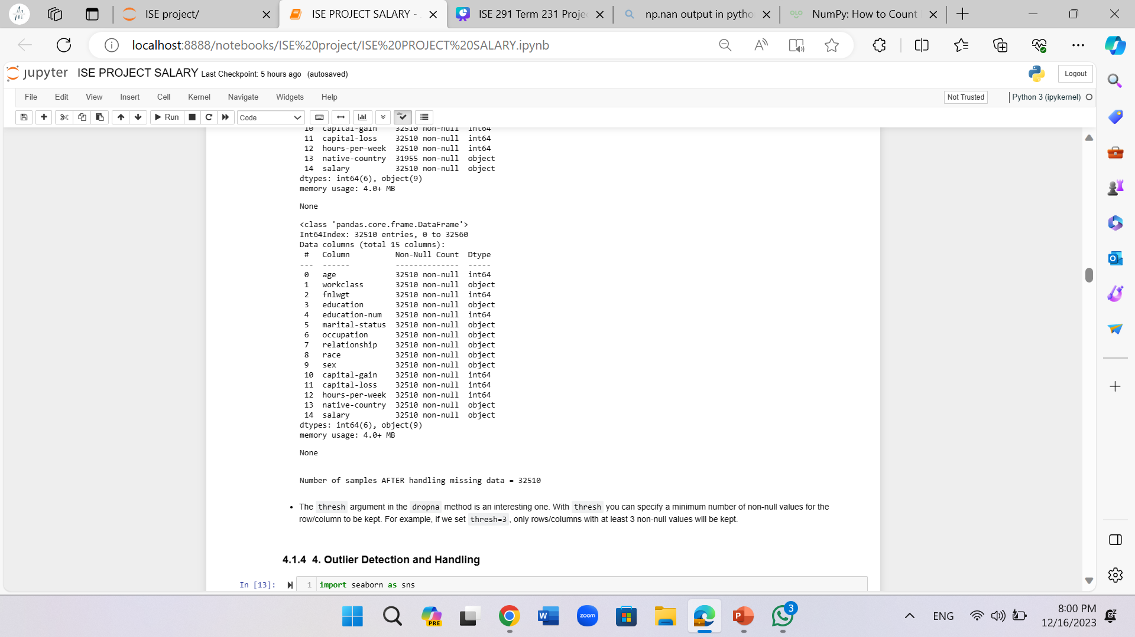
3. Handling Missing Data

Slide 17
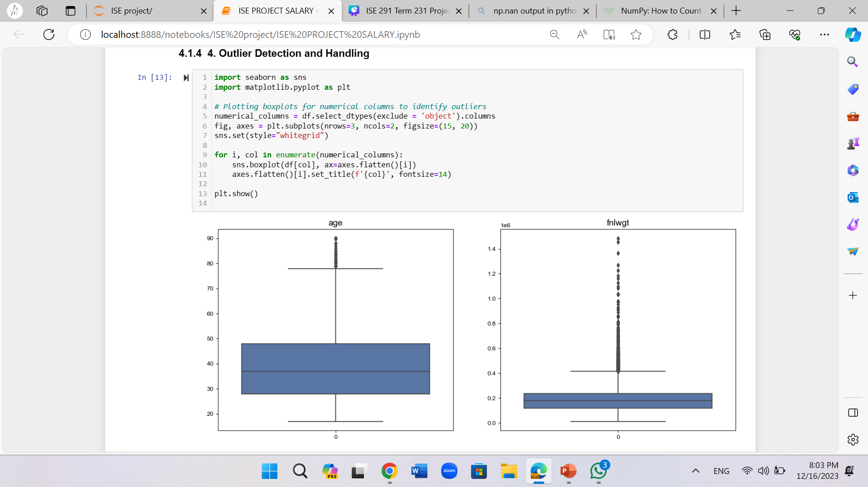
4. Outlier Detection and Handling
Outliers can significantly affect our analysis, especially in statistical models. We will identify these outliers and decide on the best course of action, whether it's to remove, adjust, or keep them based on their context.

Slide 18
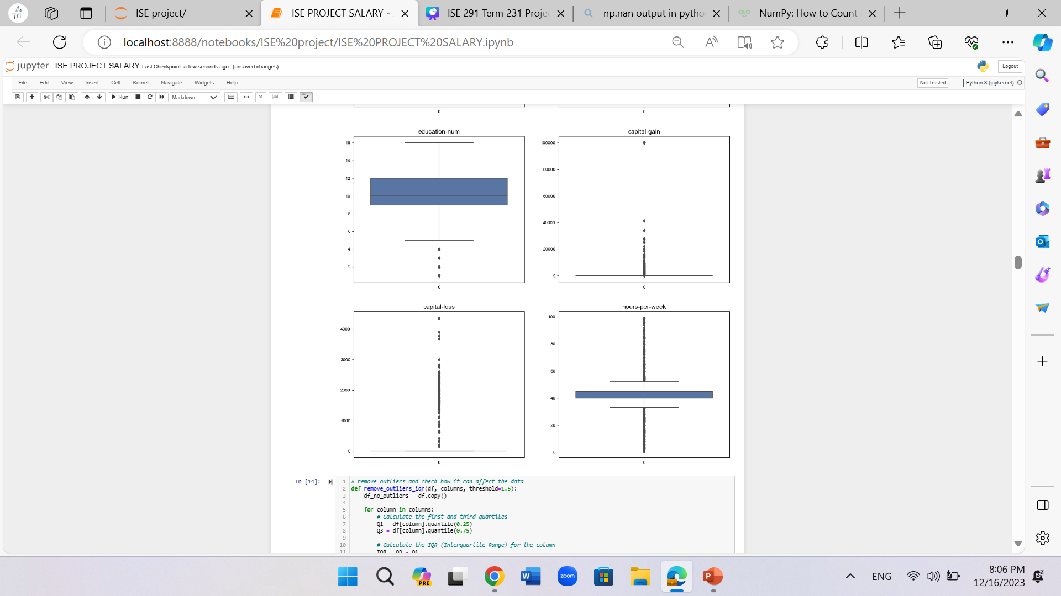

Slide 19
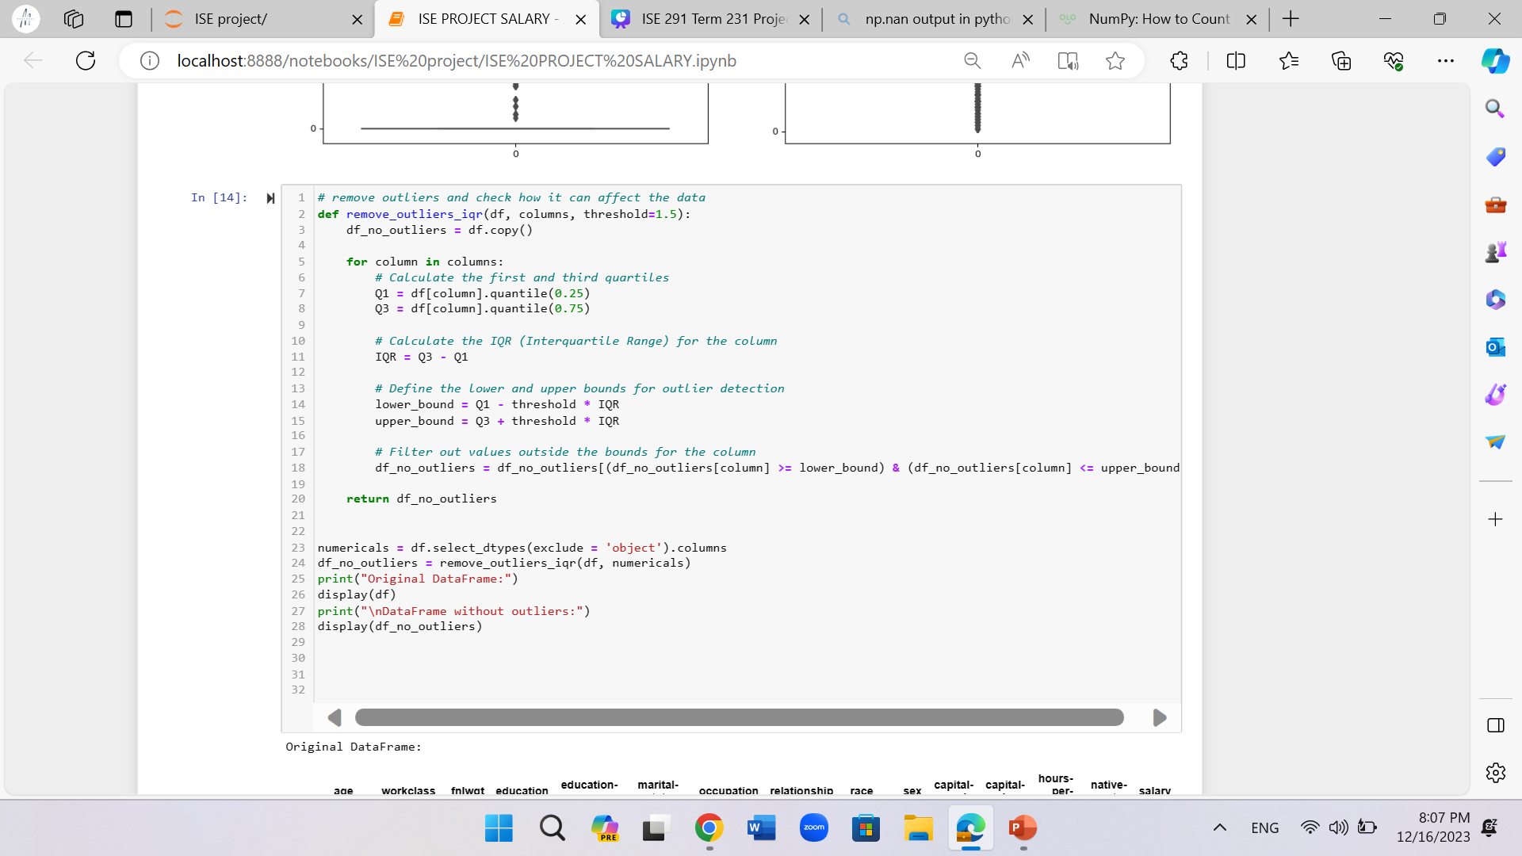
Before removing outliers: 32510 samples
After removing outliers: 18972 samples
We decided NOT to remove the outliers

Slide 20

phase3 :
Model planning

Slide 21
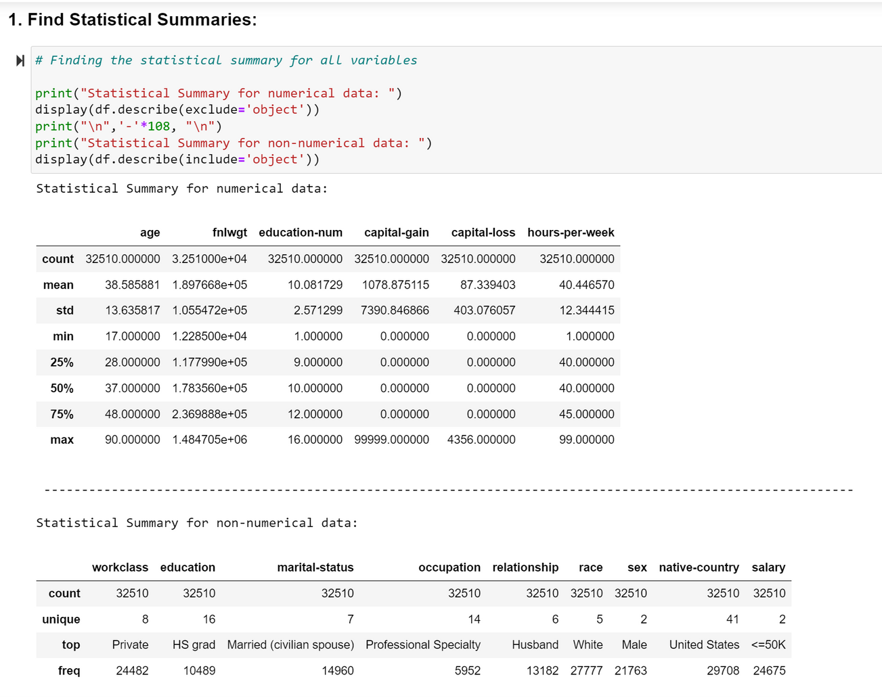
In this phase, we will analyze the data and make graphs to get a better understanding of the features. We will determine the relationship between the variables. Finally, we will summarize the findings. Following these steps will enhance our knowledge about the variables and help us select the important variables for the model-building phase. The key steps in this phase include:
1. Statistical Summary

Slide 22
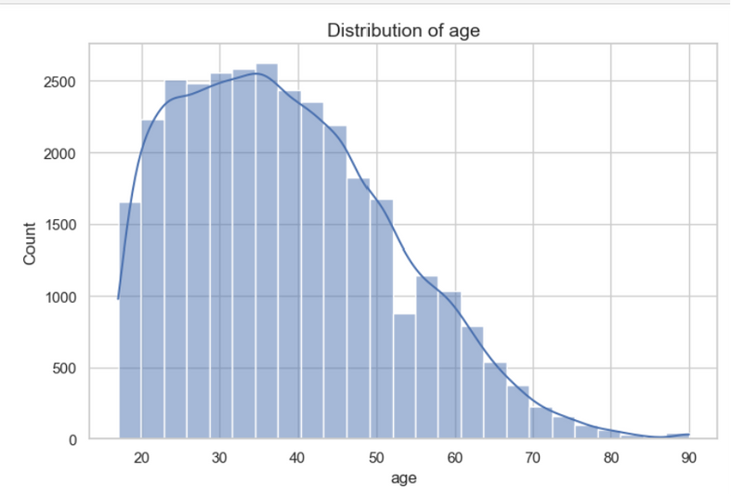
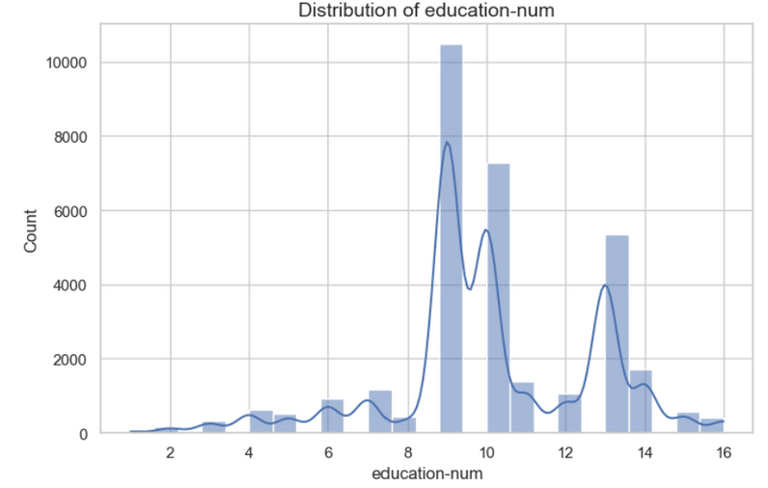
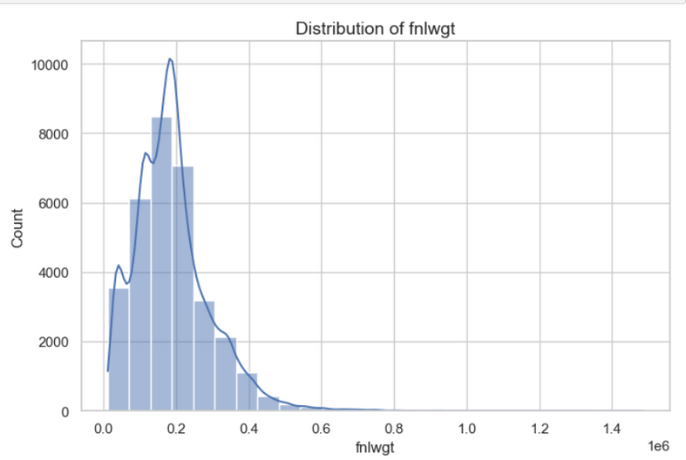
2. Univariate Graphs (Numerical features):

Slide 23
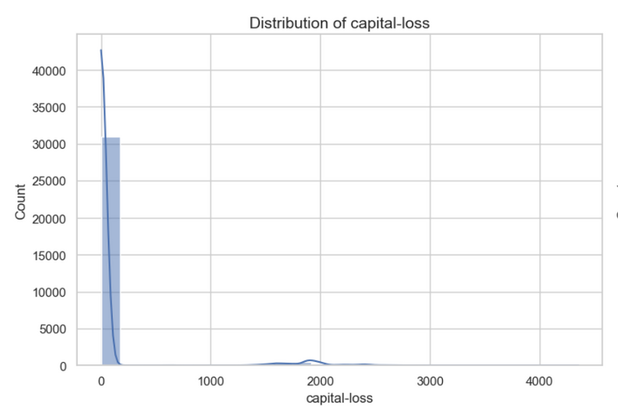
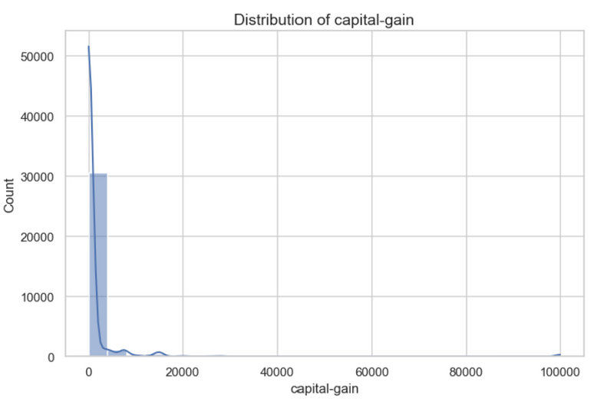
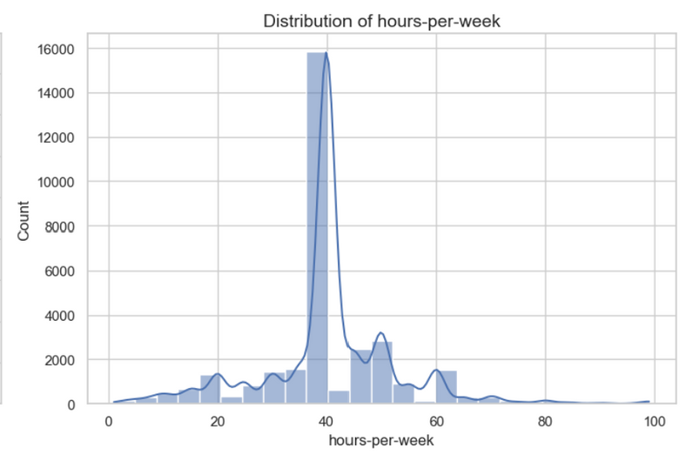
2. Univariate Graphs (Numerical features):

Slide 24
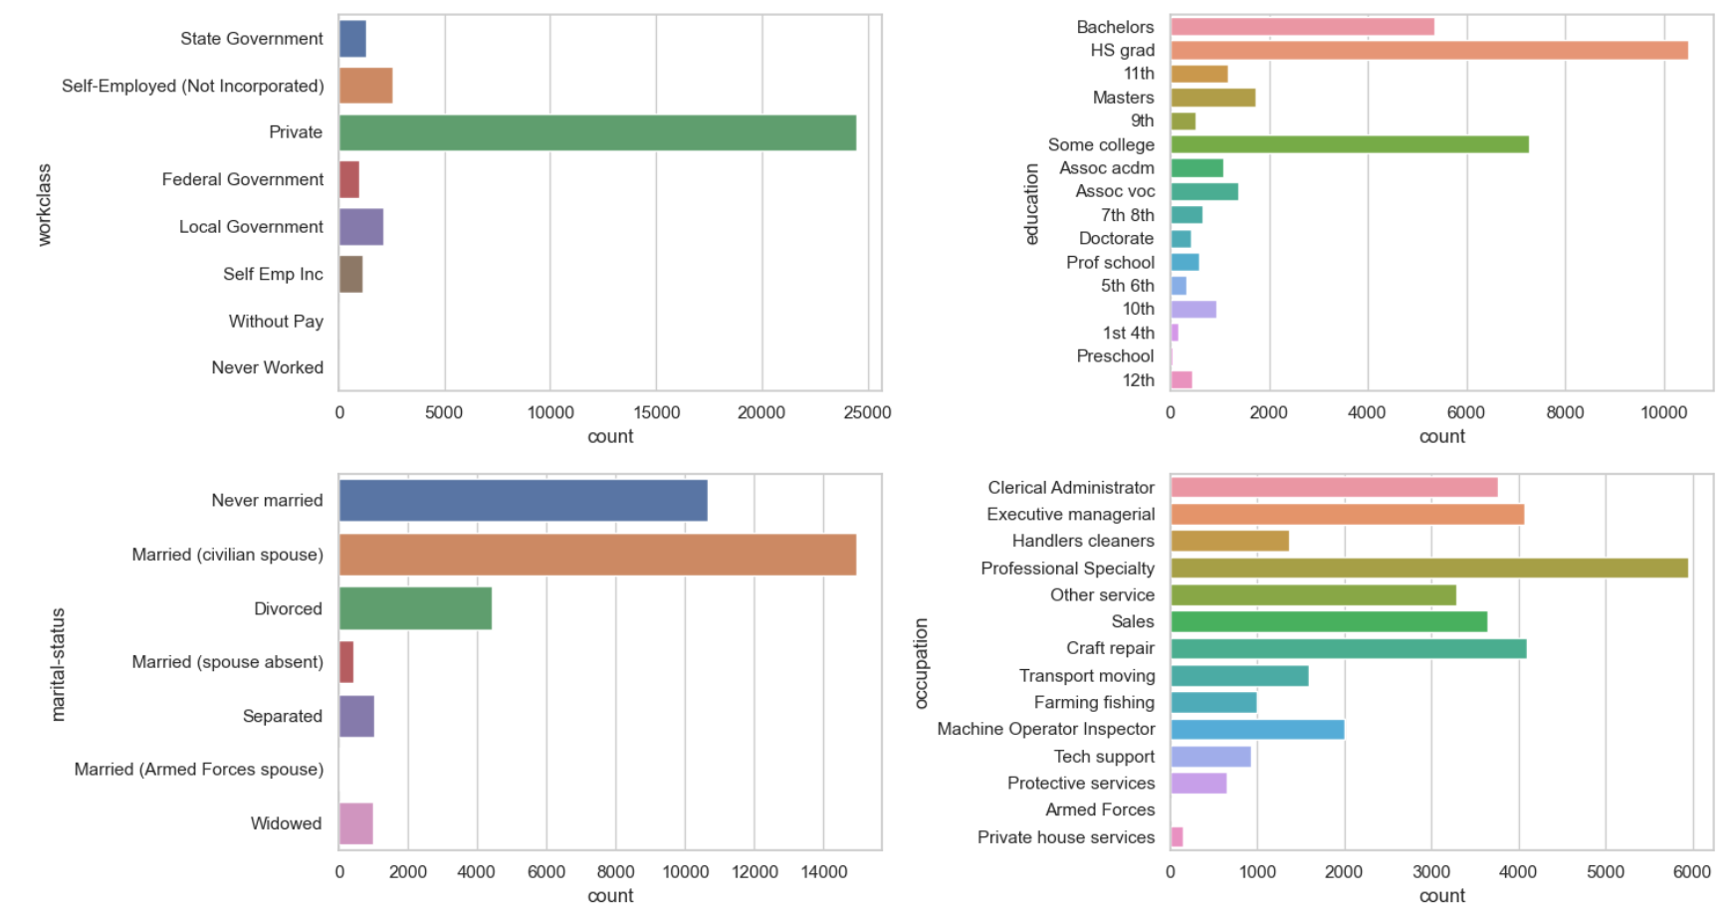
2. Univariate Graphs (Categorical features):

Slide 25
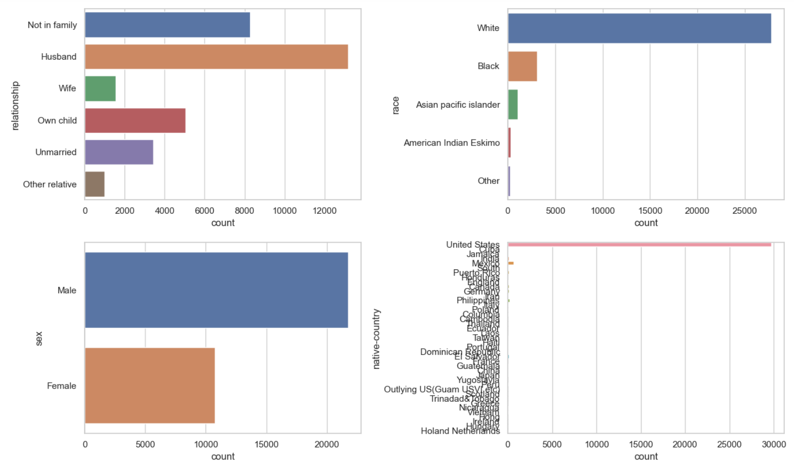
2. Univariate Graphs (Categorical features):

Slide 26
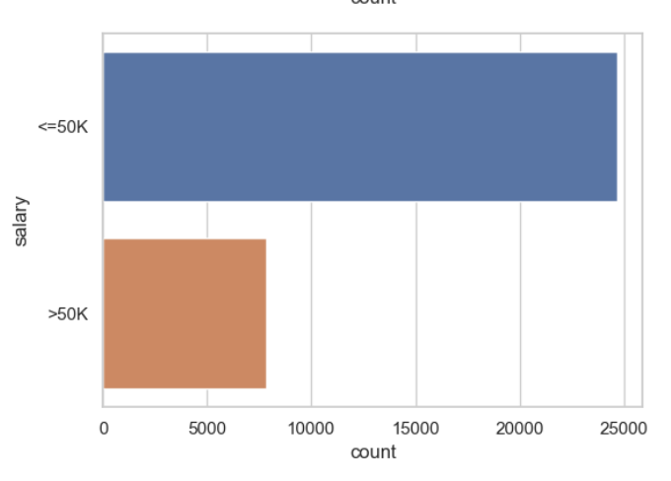
2. Univariate Graphs (Categorical features):

Slide 27
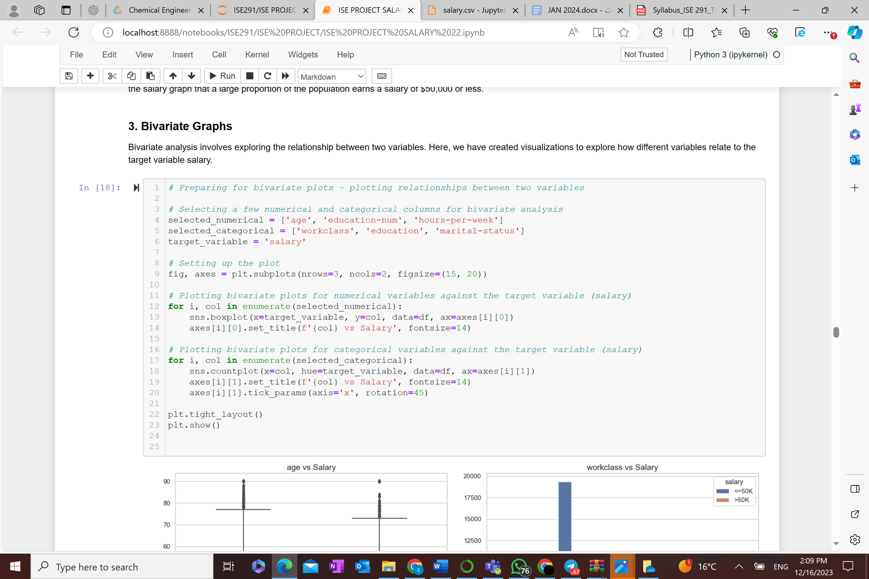
3. Bivariate Graphs: Bivariate analysis involves exploring the relationship between two variables.

Slide 28
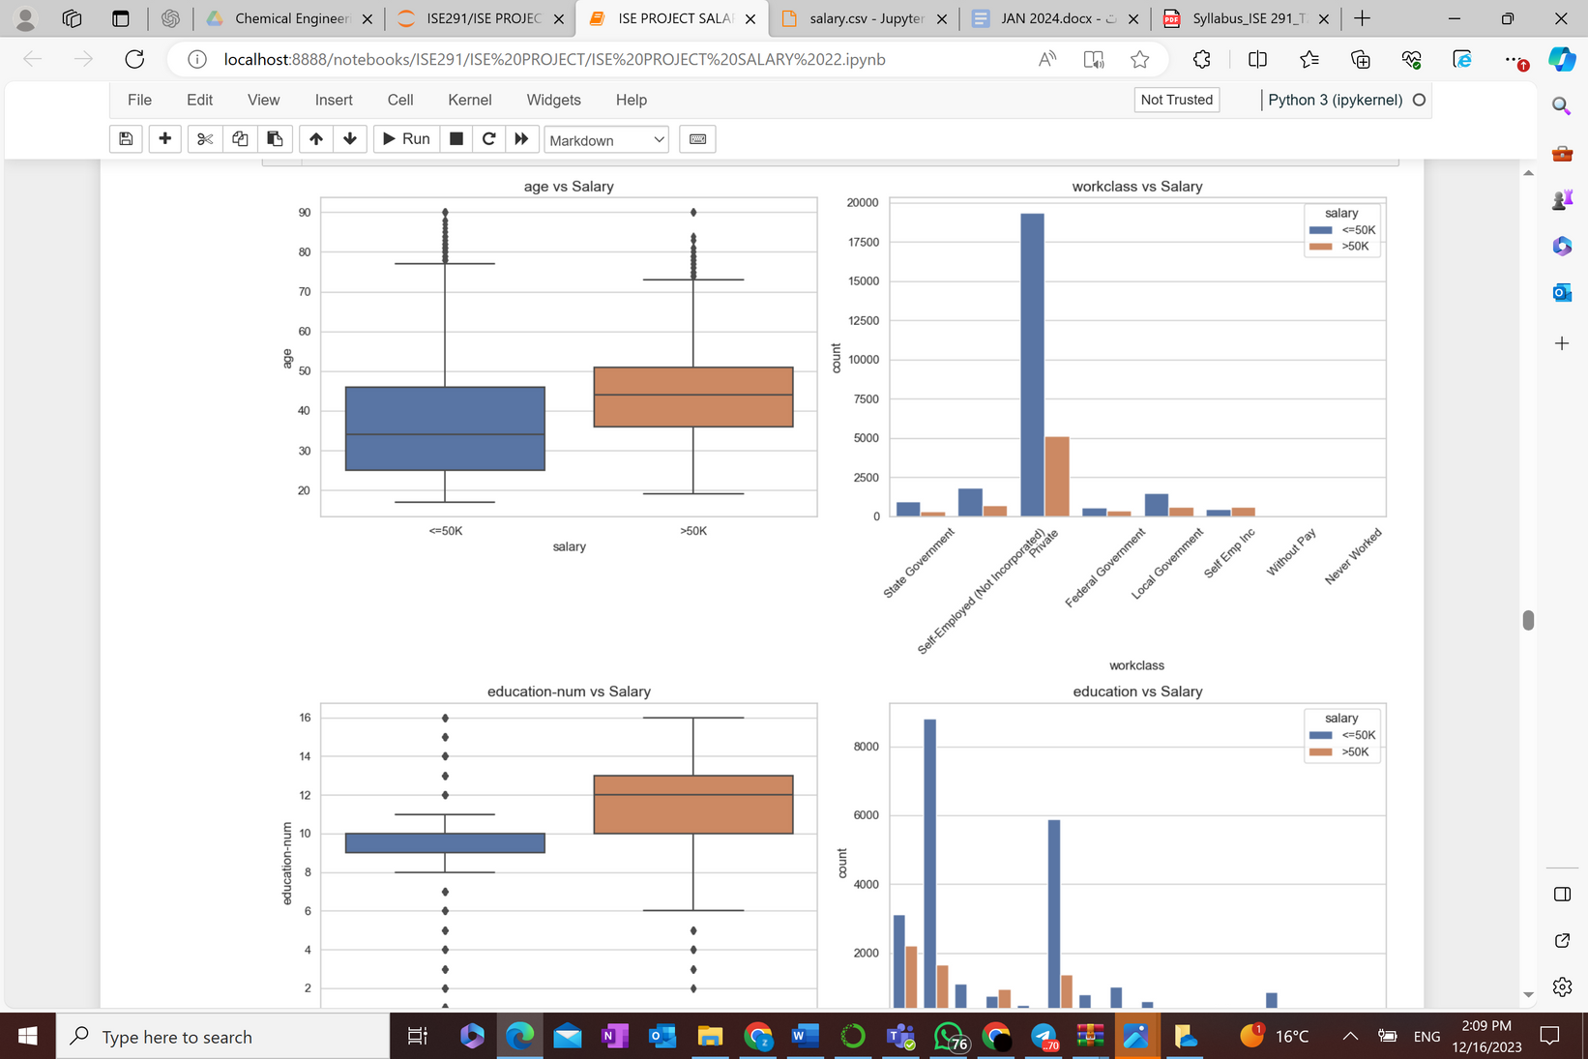
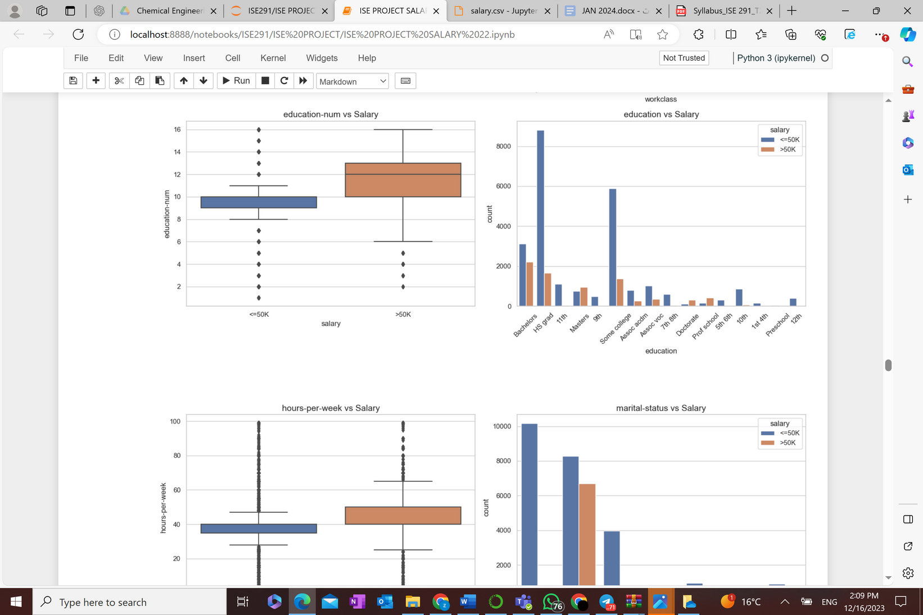
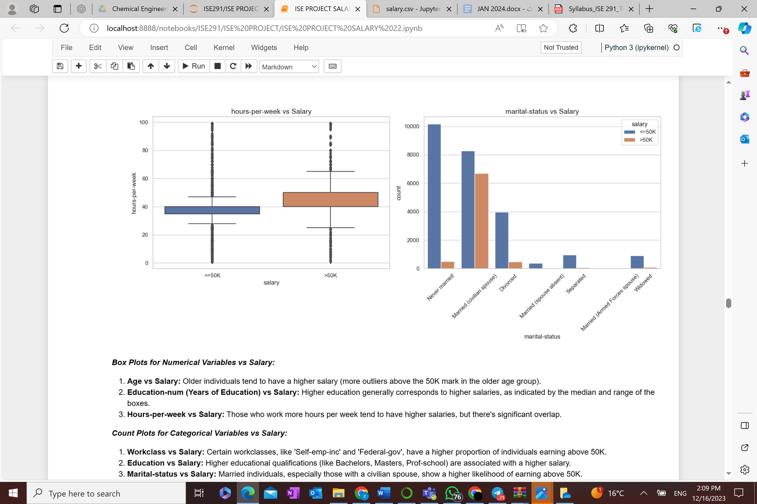
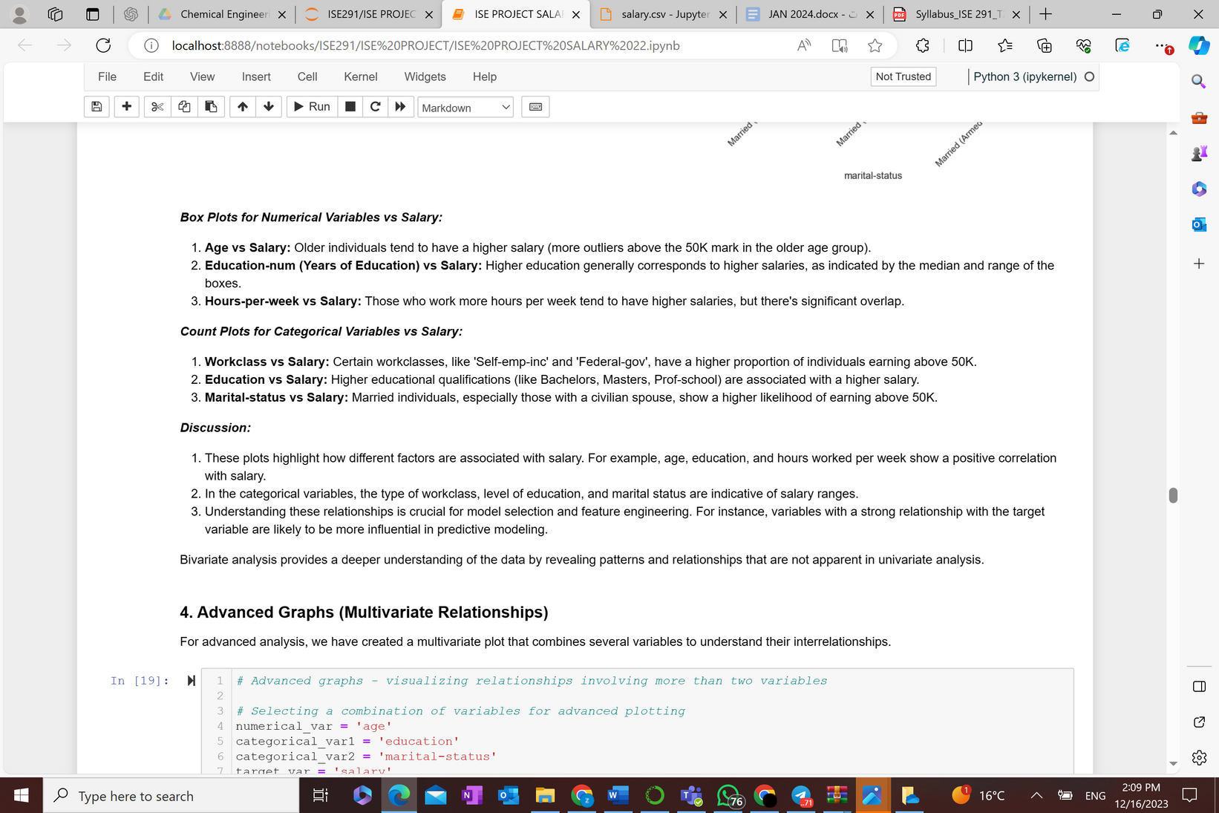

Slide 29
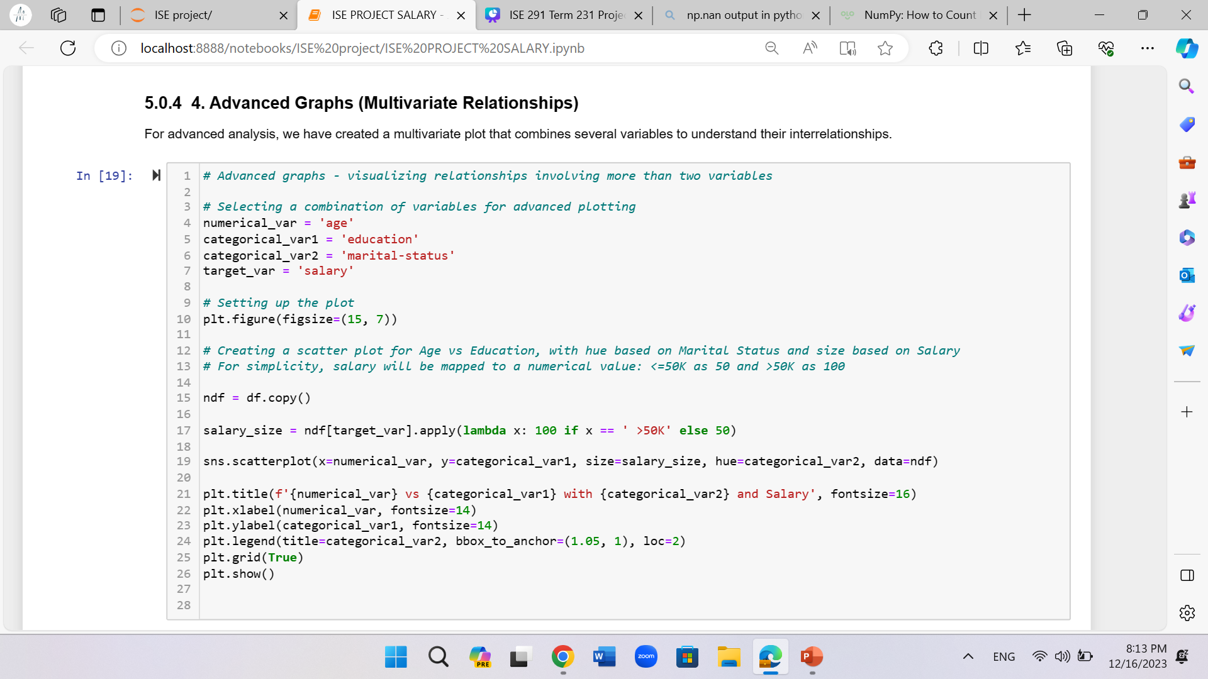
4. Advanced Graphs

Slide 30
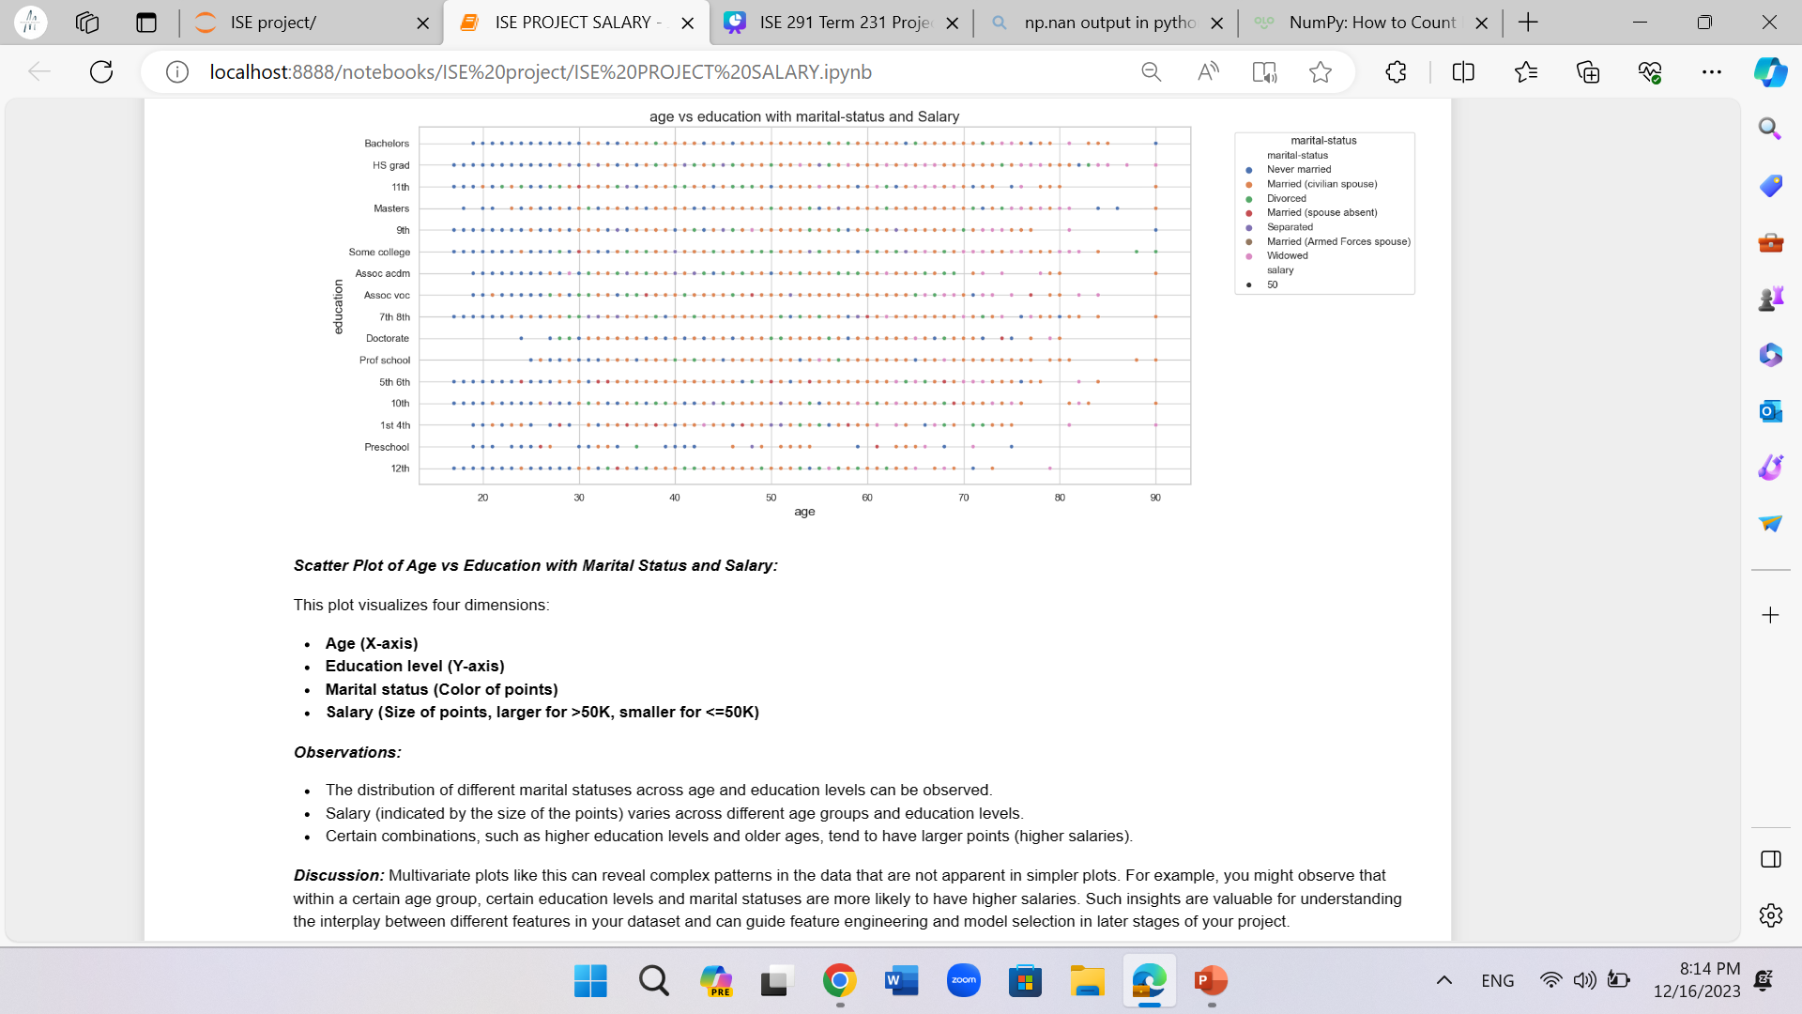

Slide 31
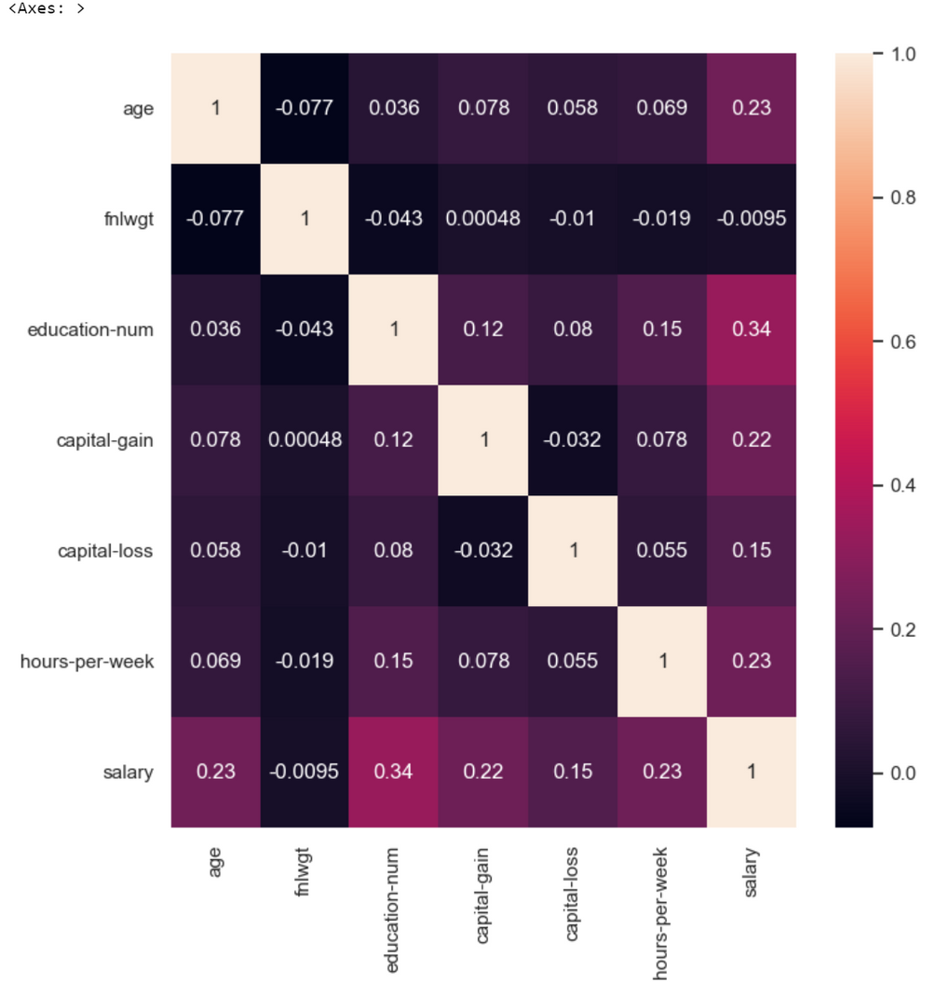
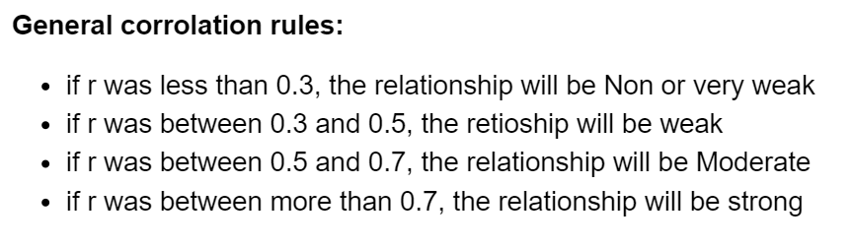
5. Correlation
To be removed:
fnlwgt (Final weight)
Capital loss

Slide 32
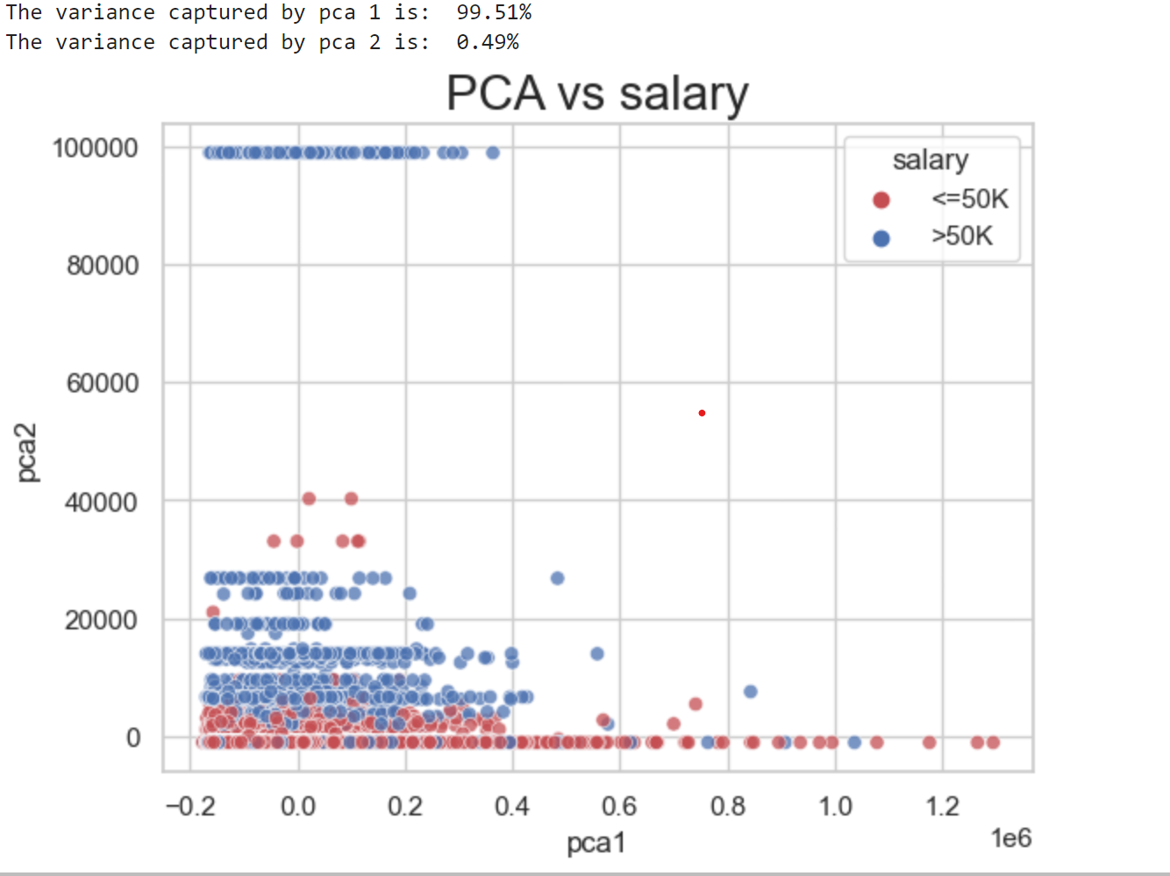
6. PCA
Represent a multivariate data table as smaller set of variables (summary indices) in order to observe trends, jumps, clusters and outliers

Slide 33
7. Summary
The analysis looked at age, education, work hours, jobs, and possibly marital status of a group. Most people were aged 25-35, a key time for important choices. Education levels show skills and learning needs. People typically work standard hours in private jobs, which affects their careers. Marital status might matter too. All this info helps give personalized advice for education and job decisions at this important stage of life.

Slide 34

phase 4 :
Model building

Slide 35
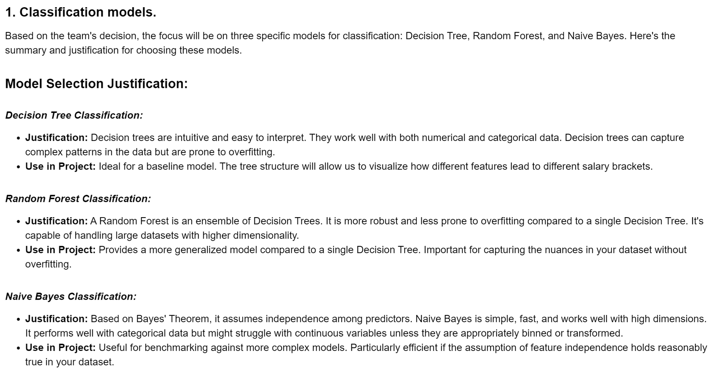
Why Classification?

Slide 36
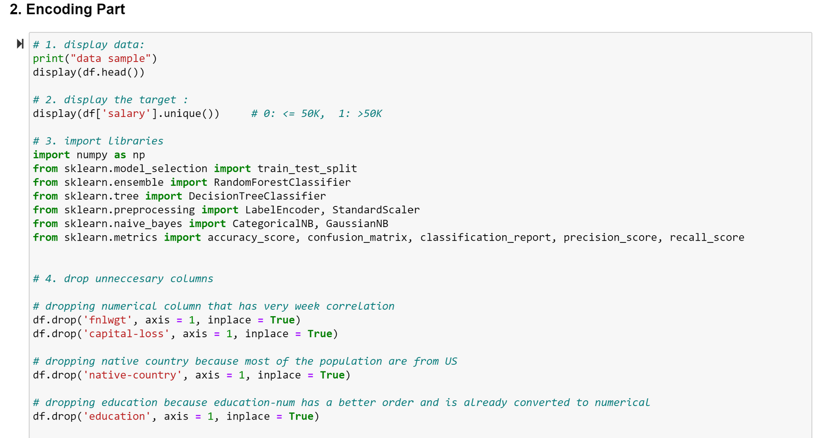
Encoding

Slide 37
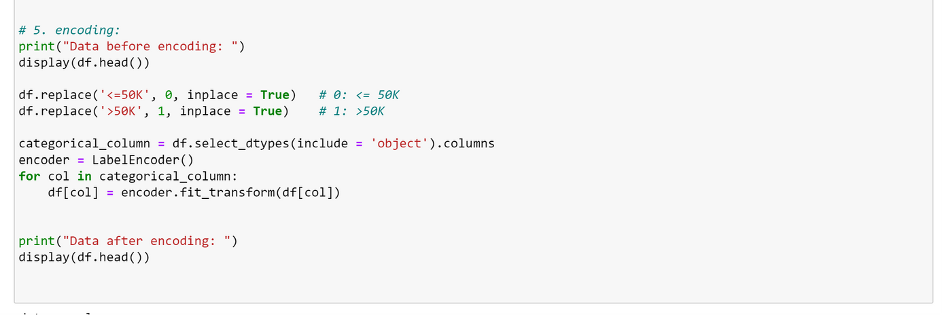
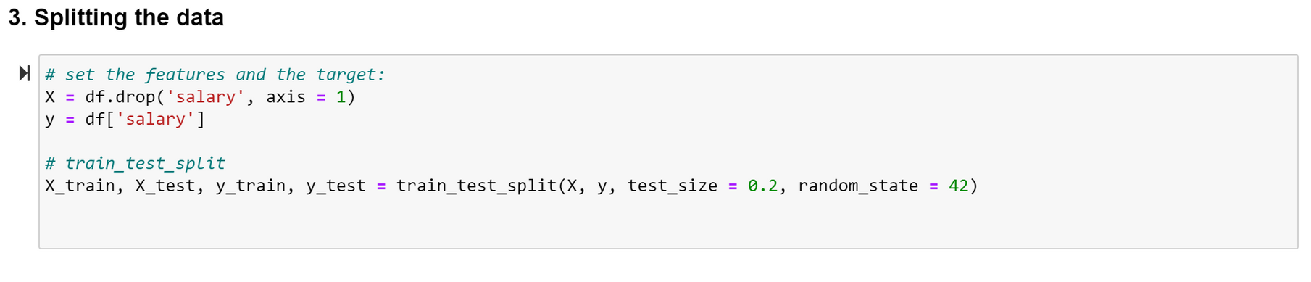
Encoding
Splitting the data

Slide 38
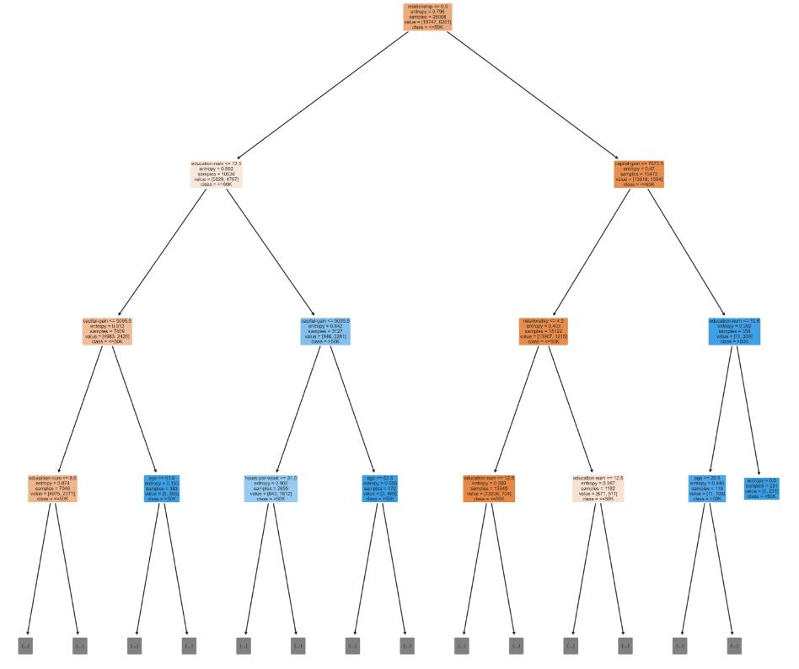
Decision Tree model

Slide 39
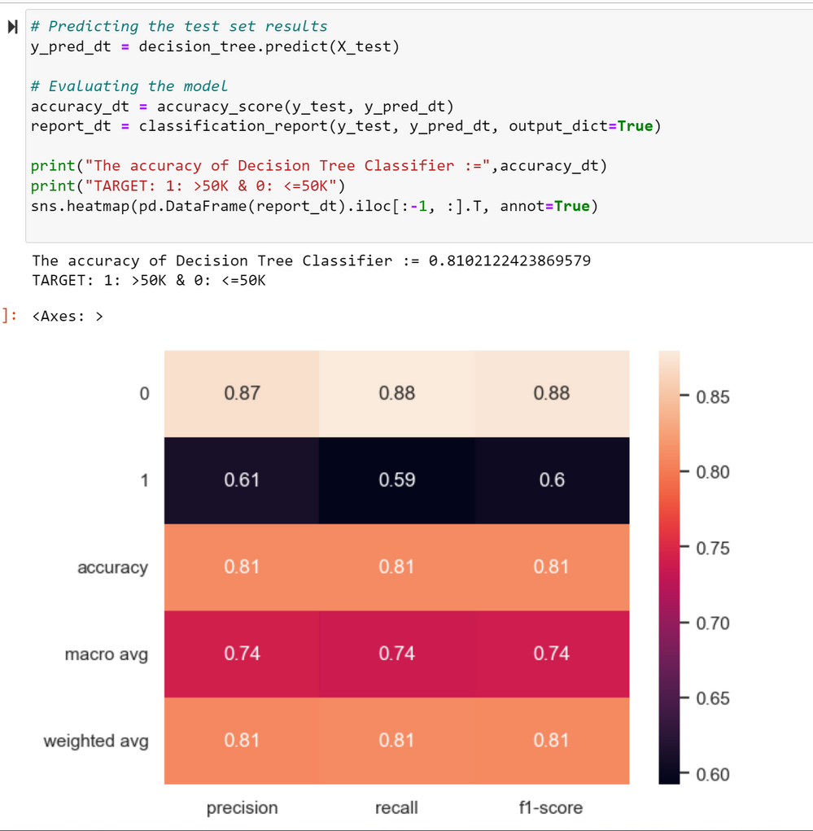
Decision Tree model (Evaluation)
Model Evaluation:
Accuracy: The model achieved an accuracy of approximately 81.02%. This is the proportion of correctly predicted instances out of the total instances in the dataset.
Classification Report:
Precision (0 class): 87% - Of all instances predicted as <=50K, 87% actually belong to this class.
Precision (1 class): 61% - Of all instances predicted as >50K, 61% actually belong to this class.
Recall (0 class): 88% - Of all instances that are actually <=50K, the model correctly identified 88%.
Recall (1 class): 59% - Of all instances that are actually >50K, the model correctly identified 59%.
F1-Score: Harmonic mean of precision and recall, with a higher score indicating better model performance.
Observations and Discussion:
The Decision Tree classifier shows a decent overall accuracy. However, there's a notable difference in performance between the two classes (<=50K and >50K), especially in terms of precision and recall.
The model performs better in identifying individuals earning <=50K than those earning >50K.
Decision Trees can be prone to overfitting, especially if the tree depth is not controlled. In this case, the model seems to generalize well but may benefit from further tuning or complexity reduction techniques like pruning.

Slide 40
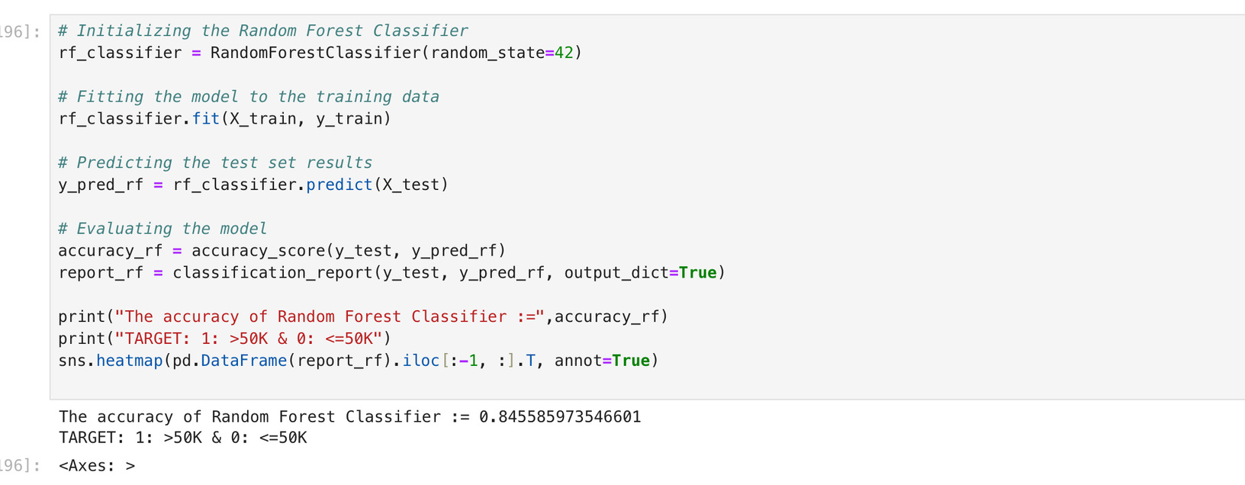
Random Forest model
Random Forest is a machine learning technique that builds multiple decision trees and combines their predictions to improve accuracy and prevent overfitting. By using random subsets of the dataset and features, it creates a robust model suitable for classification and regression tasks in diverse fields like finance and healthcare. Its simplicity, scalability, and effectiveness make it a popular choice in practical applications.

Slide 41
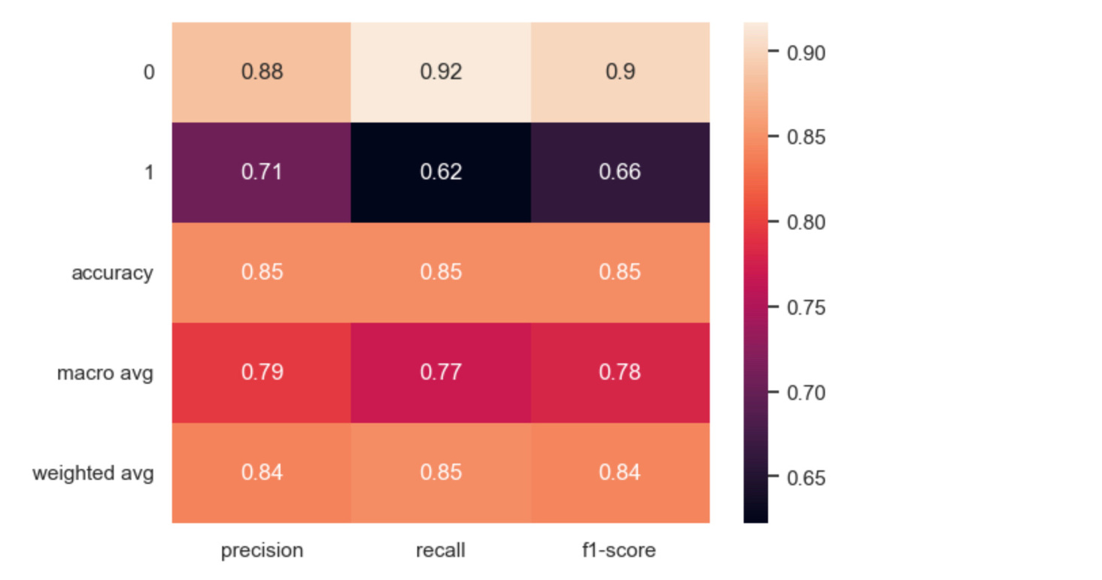
Random Forest model (Evaluation)
Model Evaluation
Accuracy: The model achieved an accuracy of approximately 84.55%. This shows an improvement over the Decision Tree model.
Classification Report:
Precision (0 class): 88% - Higher precision for the <=50K class compared to the Decision Tree.
Precision (1 class): 71% - Improved precision for the >50K class.
Recall (0 class): 92% - A higher recall rate for the <=50K class.
Recall (1 class): 62% - Similar recall rate for the >50K class as the Decision Tree.
F1-Score: Generally, the F1-scores for both classes have improved compared to the Decision Tree model.
Observations and Discussion:
The Random Forest classifier shows a significant improvement in overall accuracy and precision for both classes.
The model's ability to correctly identify individuals in the >50K class has improved without a substantial loss in recall.
Random Forest, being an ensemble of decision trees, reduces the risk of overfitting and typically performs better on unseen data.
The improvement in performance metrics indicates that the ensemble approach of Random Forest is more effective for this dataset.

Slide 42
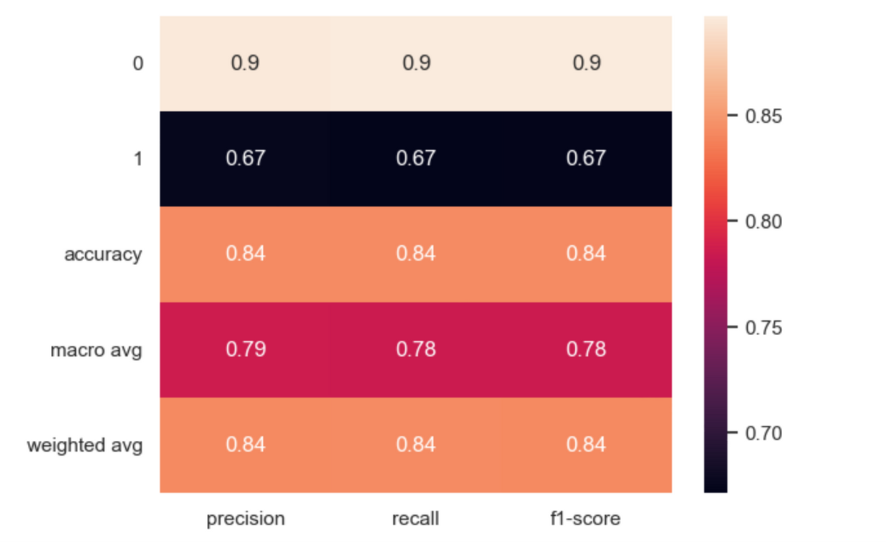
Naive Bayes model
Model Evaluation:
Accuracy: The model achieved an accuracy of approximately 84.22%. This is slightly lower than the Decision Tree and notably lower than the Random Forest model.
Classification Report:
Precision (0 class): 90% - Indicates the proportion of actual <=50K among those predicted as <=50K.
Precision (1 class): 67% - Indicates the proportion of actual >50K among those predicted as >50K.
Recall (0 class): 90% - High recall rate for the <=50K class.
Recall (1 class): 67% - High recall rate for the >50K class.
F1-Score: The F1-scores almost identical Random Forest.
Observations and Discussion:
The Naive Bayes classifier shows similar accuracy to Random Forest models.
The model demonstrates a high precision but lower recall compared to Random Forest models. However, its performance in identifying the >50K class is stronger, especially in terms of precision.
Naive Bayes is known for its simplicity and speed, but it may not handle complex relationships in the data as effectively as more sophisticated models like Random Forest.

Slide 43
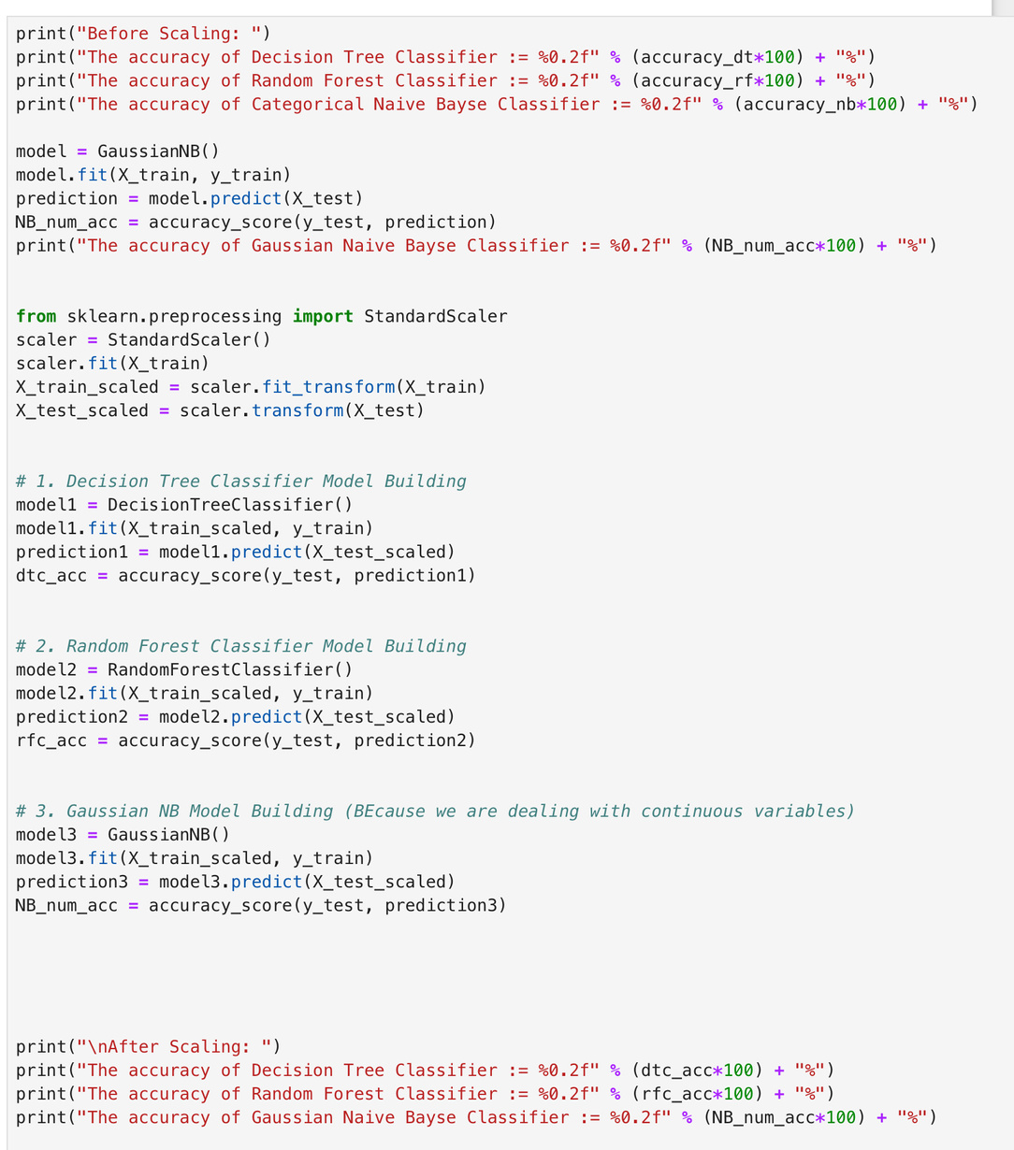
Scaling data:
Here, we will try to scale the data and check if we have different result from the unscaled data:

Slide 44
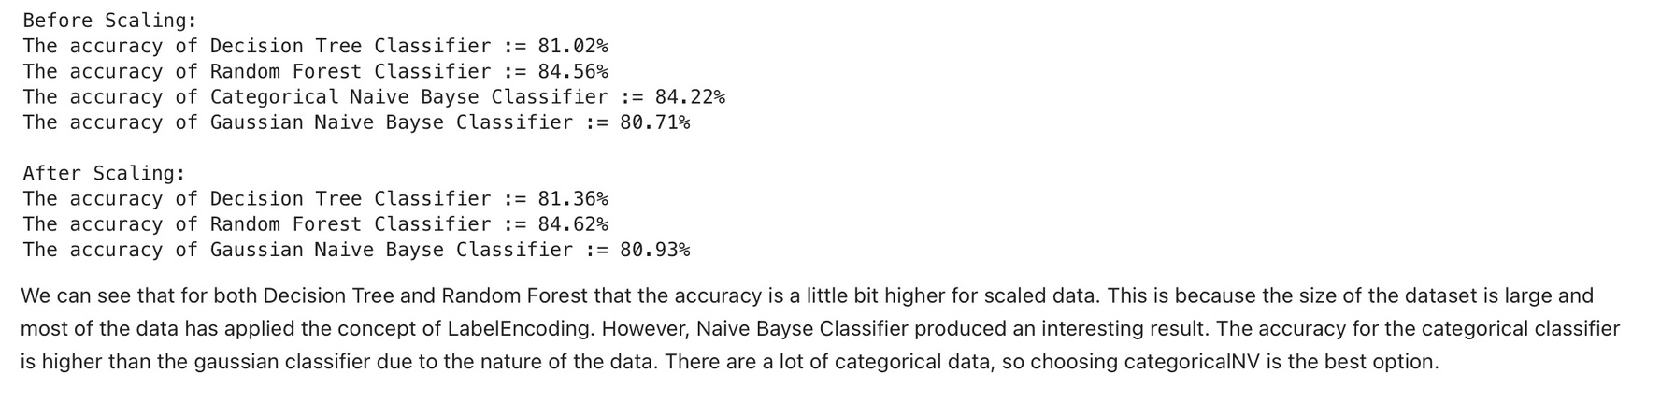
Summerize the Findings:
After scaling the dataset, both Decision Tree and Random Forest classifiers showed marginal accuracy improvements. Notably, Categorical Naive Bayes outperformed Gaussian Naive Bayes due to categorical data dominance. While accuracy matters, considering precision, recall, and interpretability, the Random Forest emerged strongest (~84.56% accuracy). Factors like age, education, and work hours influence salary predictions. Complex models (Random Forest) uncover intricate patterns but sacrifice interpretability, contrasting with the simpler Decision Tree. Despite slight accuracy gains post-scaling, the Random Forest, balancing between accuracy and interpretability, proves a robust choice for this diverse dataset.

Slide 45
phase 5 :
Operationalize

Slide 46
Phase 5:
The comprehensive analysis demonstrated that meticulous data cleaning, exploratory visualizations, and strategic feature selection are pivotal in achieving an impressive 84.56% accuracy using the Random Forest Classifier. This highlights the critical role of data refinement and preparation in enabling accurate predictions of salary disorders in individuals.

Slide 47

phase 6 :
Communicate Results

Slide 48
Phase 6:
In Phase 6, the emphasis lies on the foundational aspects of data preparation, model selection, and continuous evaluation. It stresses the need for maintaining high-quality data, choosing models tailored to specific requirements, and consistently assessing model performance using updated data. This ensures the practical applicability and longevity of predictive models in real-world scenarios, providing a roadmap for effective implementation.

Slide 49
THANK YOU

